Slide 1
ANANKE: a Q-Learning based Portfolio Scheduler for Complex Industrial Workflows
Presentation: Shenjun Ma
Shenjun Ma
Ir. Alexey Ilyushkin
Alexander Stegehuis
Prof. dr. ir. Alexandru Iosup
@Large research: https://atlarge-research.com/
Notes:
Good morning/afternoon/evening everyone.
I am delighted to be here today to talk to you about Q-Learning based Portfolio Scheduler for Complex Industrial Workflows

Slide 2
What is a workflow?
Notes:
You have serval steps to do:
Decide who is your supervisor
Define a research topic
Write a proposal
Do research and write your thesis
Prepare a presentation and show it at your defense
Certain dependencies between steps.
Follow the order

Slide 3
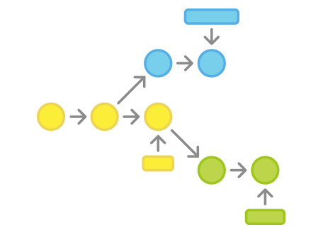
Workflows are used in industrial applications
Sensor data processing is commonly defined as workflows
Many industrial applications
A logical sequence of the dependent tasks
Notes:
A workflow is a logical sequence of the dependent tasks.
Although the definition is simple, this concept is commonly used in processing scientific jobs.
However, nowadays, workflows are also used in many industrial applications for sensor data processing.
Companies like Shell and CGI use workflows in the monitoring and diagnosis system for maintaining their equipment.

Slide 4
Industrial workflows have special features and requirements
Analyze workloads in production
Recurrent patterns
Sensors collect data with a constant rate
Deadline constraints
Monitor asserts in real time
Workloads may evolve over time
New type of sensor data is introduced
New type of sensor is applied
Notes:
To better understand the industrial workflows,
we investigate the workloads in production …
We found some special features and requirements.
Industrial workflows may have recurrent and periodic patterns ….
Besides, Deadline constraints are assigned to workflows ….
Workloads also evolve if new type of sensor data is introduce to the system …
Although industrial workflows may not have complicated structure as scientific workflows have, these requirements also make the industrial workflows quite complex!

Slide 5
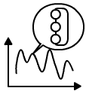
Use clouds to reduce cost
Need an efficient scheduler!
Consider the features of industrial workflows
Notes:
Workflows are often processed in clouds to reduce cost.
An efficient scheduler mapping workflows to clouds infrastructure is the key to save operational cost.
To achieve the benefits of clouds when processing industrial workflows, companies need to apply a smart scheduler which can consider the features and requirements of industrial workflows.

Slide 6
Scientific workflows scheduler?
Scientific Workflow
Industrial
Workflow
It is scientifically challenging to cover all these features and requirements
Notes:
By far, you may argue that since scientific workflows have been studied for decades,
Why not just select a suitable scientific scheduling approach and apply it on industrial workflows?
Sadly, it doesn’t work.
The reason is simple: the Industrial workflow does not equal to the scientific workflow.
They may share some common features.
However, there are many features of industrial workflow are not covered by scientific workflows.
Thus scientific scheduling approaches do not consider feature and requirements of industrial workflows.
Simple scientific scheduling approach such as threshold based scheduling policy does not consider the recurrent pattern
heuristic scheduling approach optimized for a certain scenario does not perform optimal any more when workloads evolve.
We find it is challenging to…

Slide 7
Standard Portfolio Scheduler, Why?
Notes:
Since scientific scheduling approach does not work, how to solve the workload evolution issue?
Build a development team and force them to release a new scheduling policy whenever new types of sensor date are introduces or new sensors are applied.
Use some fancy learning techniques and a bit of magic to implement an ultimate static scheduling policy which can handle all kinds of workload once for all.
You prepare a set of relatively simple scheduling policy and select among them the best one for different workloads.
PS has two steps:
Internally it maintains 3 component.
A set of scheduling policies
A simulator perform simulation on each policy based on the current presented workload and system status.
An utility function used to evaluate simulation results numerically.
The zoom-in block shows that PS selects …
The ability to dynamically select the best policy solve the workload evolution issue.

Slide 8
Standard Q-Learning Algorithm
Notes:
Q-Learning Policy can gain knowledge by tracking performed scheduling actions.
It maintains a decision table and stores the reward value of all pervious performed actions in the table.
This table late is used for action prediction.
Every time QL makes a scheduling decision, it queries the table for the suitable action.
By learning form historical information, QL can take advantage of the recurrent pattern.

Slide 9
Q-Learning + Portfolio Scheduling
Our approach:
Take the advantage of recurrent patterns
Address the workload evolution and deadline constraints
Notes:
PS and QL looks feasible to solve our problems.
However, PS and QL alone can not cover all the features of industrial workflows.
To address the challenges, our approach combines QL and PS.
Q-Learning can take the advantage of recurrent patterns by learning form historical information.
And Portfolio scheduling can address the workload evolution and deadline-constraint requirements.

Slide 10
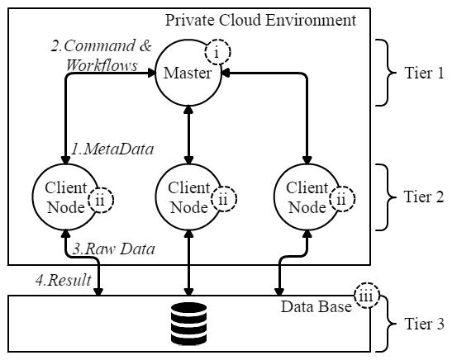
The Smart Connect Framework at Shell
Workflow and Resource Management
Notes:
In this work, we build ANANKE on top of a sensor data processing framework used by Shell in the Smart Connect Project.
Smart Connect monitors and diagnose equipment by analyzing sensor data.
The red area is where the sensor data being processed.
ANANKE is also deployed in this area to manage workflows and resource.
The Framework use typical three-tier architecture composed by a single master node and multiple Client nodes.
Note that the client node can process workflows in parallel by using threads.
So thread is the smallest working unit.

Slide 11
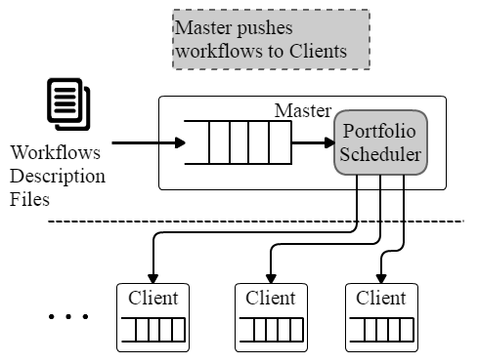
How to adapt the standard portfolio scheduling to our problem?
Notes:
To apply QL and PS together in the sensor processing framework, The first question we need to answer is how to adapt the portfolio scheduling?
The original approach without PS uses a pulling model.
The client nodes periodically pull workflows form the master nodes.
We decide to integrate ANANKE (our portfolio scheduler) in the master node and let it decide which workflow is pushed to where.
The pulling model is replaced by a pushing model.

Slide 12
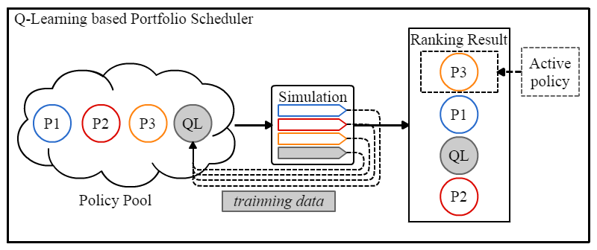
How to apply the Q-Learning technique to our problem?
Notes:
To take the advantage of recurrent pattern, we also need to find a solution to adapt Q-Learning policy with portfolio scheduler.
Different form simple threshold based policy, QL policy need to be trained before it can make accurate scheduling decision.
We use online training in our approach to save additional training effort when workloads evolve.
Besides, long training time is also not acceptable in a real-time monitoring system.
One approach to speed up the training process is to find more training data.
Thus our approach-ANANKE uses the data generated by the simulator to train the Q-learning policy.
As shown in the figure, action performed during the simulation is collected and feed to the QL.
This mechanism help ANANKE to train the learning policy quickly.

Slide 13
How to evaluate the Q-Learning-based portfolio scheduler?
Real-world experiments based on a prototype implementation
Realistic experimental environment: DAS-5
DAS is often used to emulate cloud operations
1 Master node; 3-50 Client nodes
CPU: Intel E5-2630v3 2.4GHz
RAM: 64 GB
Network: 1 GB/s Ethernet links
Notes:
To prove that our approach can manage industrial workflow well, we conduct real-word experiments for evaluation.
All the experiments are performed on DAS-5.
DAS provides a common computational infrastructure and often used to emulate cloud operations.
We list some important parameter for our experimental environment.

Slide 14
Synthetic Experimental workload, with realistic parameters derived from real-world deployment
Dynamic
Static
Notes:
We use synthetic workload in our experiments.
The experimental workload is derived from real-world workflow from Smart-Connect with realistic parameters.
We design four different workloads and group them into two types.
The horizontal axis represents experiment time and the vertical axis represents the number of arriving workflows.
The dynamic workloads have periodic arriving peak over time and the static workloads are uniformly distributed over time.
We only show part of results in this presentation

Slide 15
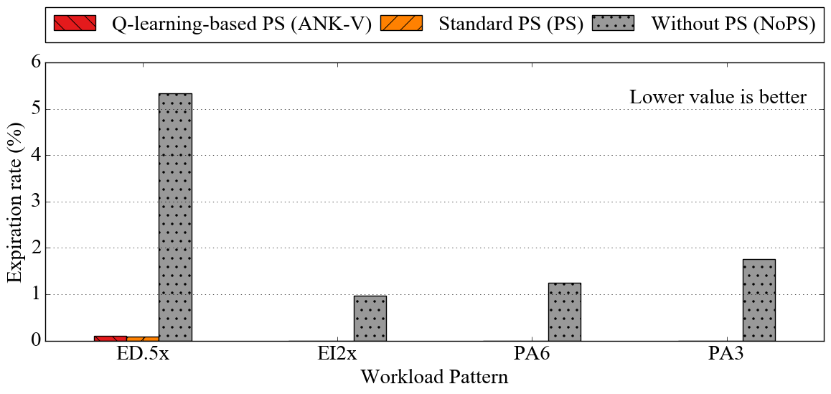
Key Deadline Metrics: Expired Workflows (#Clients Nodes: 3)
few
none
none
none
Both meet the deadline-constraints!
Notes:
We first want to verify if ANANKE (our approach) meet the deadline constraint requirements.
We use the standard portfolio scheduler and the original approach without portfolio scheduling as baseline.
The plots show the ratio of expired workflows.
ANANKE and standard portfolio schedulers meet the deadline-constraint requirements because they have very few expired workflows.

Slide 16
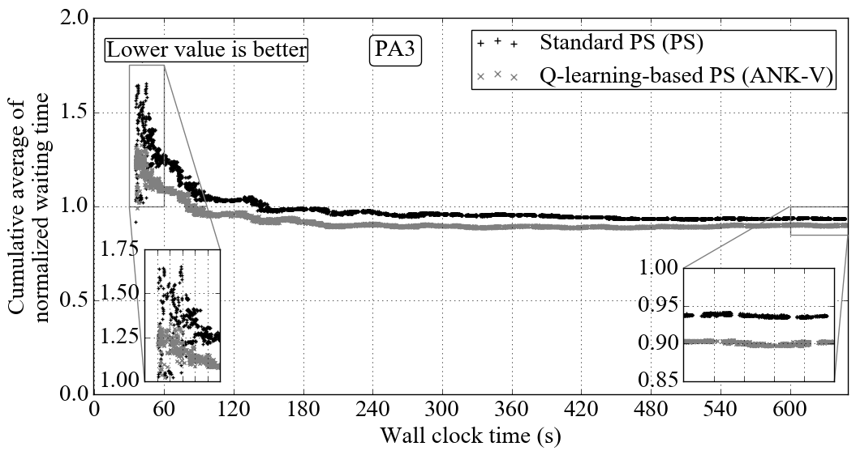
Key User Metrics: Workflow performance across portfolio schedulers (#Clients Nodes: 3)
ANANKE has better performance with static workloads!
Notes:
To further study the performance between ANANKE and standard portfolio scheduler, we compare the average waiting time.
the horizontal axis represents experiment time.
The vertical axis represents the workflow waiting time normalized by the response time and the lower value is better.
The gray line is always below the the black line during the experiment indicating our approach provide lower waiting time.
We find that ANANKE provides a better workflow performance with a static workload.

Slide 17
Elasticity: Supply and Demand
5 Auto Scalers
2 ANANKE implementations
3 baselines
Supply: Number of active threads
Demand: Number of running and near deadline workflows
Notes:
To evaluate the elasticity of ANANKE, we analyze the supply and Demand.
We use 5 auto-scalers: 2 ANANKE implementation and 3 baselines implementation.
The baselines includes:
a stander portfolio scheduling policy,
A threshold-based policy without portfolio scheduling and
a static allocating police without scaling ability
We use the number of active threads to represent supply and
Use number of running and near dealing workflows to represent demand.

Slide 18
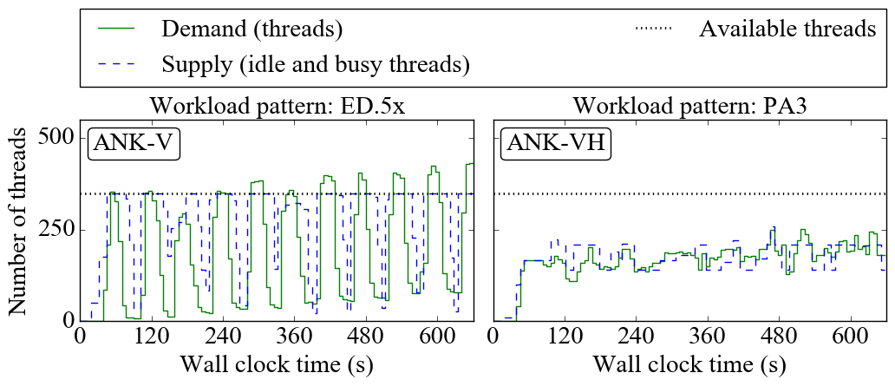
Supply and Demand Analysis
ANANKE has the best elasticity among the candidates!
Notes:
The full results can be found in my thesis
Here is two examples of what we observed in the elasticity evaluation experiments.
You can see the Demand and Supply curve change during the experiment.
In general, we want the supply curve close to the demand curve
because the gaps between supply and demand means you either have over provisioning issues or under provisioning issue which should be avoided.
According to our observations, ANANKE has the best elasticity among the 5 candidates.

Slide 19
Performance Degradation Analysis
Resource cost: Lower is better
Degradation: Closer to zero is better
ANANKE has the best user-experienced performance with the lowest resource cost!
Notes:
As we all know, saving resource may lead to user-experienced performance degradation.
We want to verify that ANANKE doesn’t have this issue.
Here we use average number of active thread to represent resource cost and throughput to represent user-experienced performance.
For #threads: Lower is better, For Throughput degradation: Closer to 0 is better
Look at the second row, …
Form the evaluation results; we can conclude that ANANKE achieves the best user-experienced performance with the lowest resource cost.
[How]
PS-(VR) uses 48–52% less resources, it also causes higher throughput degradation (–1.96 workflows per second).
ANK-VH has lower throughput degradation from –0.14 to –0.11 workflows per second which is 0.68–0.8% of the baseline throughput and saves from 42.8% to 48.2% of resources.
Our horizon-tally and vertically elastic approach (ANK-VH) can save from 24% to 36% resources with at most 1.4% throughput degradation.

Slide 20
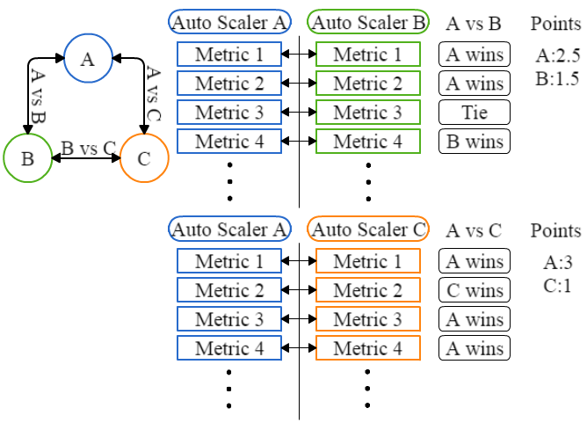
Comprehensive Comparison between auto-scalers
Numerical methods
Pairwise Comparison
Fractional Difference Comparison
9 related metrics
system- and user-oriented metrics
Full results are in the thesis
ANANKE has the best elasticity
Notes:
Visually comparing the gap between supply and demand curves is not sufficient because it only tell which AS perform better.
However, we also want to know how much better the winner outperform.
We thus conduct comprehensive comparison using two numerical methods on 9 related metrics including system- and user- oriented metrics.
full results of the comprehensive comparisons are included in the thesis. Here is an example of Pairwise comparison.
Like organizing football match between multiple teams. (AS = team, comparison = match)
For each auto-scaler, we compare the value of each metric with the value of the same metric from all the other auto-scalers.
Auto-scaler performing better on a certain metric wins and gets 1 point.
If it is a draw, each auto-scaler gets 0.5 points. Wining more points indicates better elasticity in general.
Combining the results of the comparisons, we verify again that ANANKE has the best elasticity.

Slide 21
Conclusion
Design and implement ANANKE
a Q-learning based portfolio scheduler
Complex industrial workflows
Evaluate through real-world experiments
Better user-experienced performance, resource utilization and elasticity for relatively static workloads
For highly dynamic workloads, using Q-learning is less beneficial, but still positive
Notes:
In this work, we design and implement a Q-learning based portfolio scheduler and evaluate its performance through real-world experiments.
We find that our approach provides better user-experienced performance, resource utilization and elasticity for static workloads.
However, using Q-learning is less beneficial for dynamic workloads.

Slide 22
Future Work
Different type of simulators
Different learning techniques
Advanced mechanism to control/restrict the simulation time
Apply on hybrid environment
Notes:
the current PS uses a event driven based simulator, we tend to use different type of simulator.
Apply different learning techniques to meet more complicated requirements
Study on mechanism to speed up the simulation process for high performance computing.(Simulation time is proportional to the workload size)
Apply our approach on hybrid environment

Slide 23
Thanks
Q&A

Slide 24
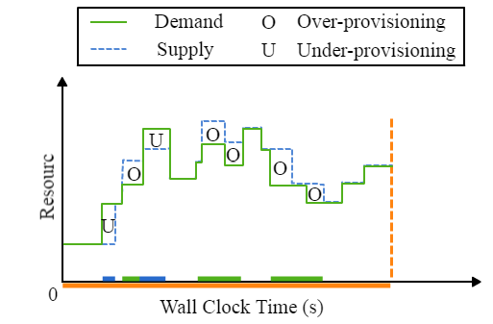
Key concept for auto scaling: Demand and Supply
Over- and under- provisioning
should be avoided
Ilyushkin, A., Ali-Eldin, A., Herbst, N., Papadopoulos, A. V., Bogdan, G., Epema, D., & Iosup, A. (2016). An Experimental Performance Evaluation of Autoscaling Algorithms for Complex Workflows. In ACM Symposium on Cloud Computing 2016 (SOCC 2016).
Notes:
[How]

Slide 25
Pairwise Comparison
ANANKE with vertical scaling outperforms the candidates in static and dynamic workloads
Higher value is better
Ilyushkin, A., Ali-Eldin, A., Herbst, N., Papadopoulos, A. V., Bogdan, G., Epema, D., & Iosup, A. (2016). An Experimental Performance Evaluation of Autoscaling Algorithms for Complex Workflows. In ACM Symposium on Cloud Computing 2016 (SOCC 2016).
Notes:
[How]

Slide 26
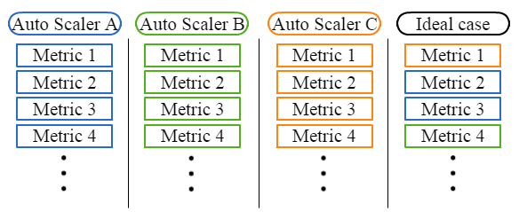
Fractional Difference Comparison
ANANKE with vertical scaling and horizontal scaling ability performs best
Lower value is better
Notes:
[How]

Slide 27
Appendix: Comprehensive Comparison Results

Slide 28
Appendix: Research Questions
How to adapt portfolio scheduling?
How to use learning technique and historical information?
How to evaluate the learning-based portfolio scheduler?

Slide 29
Appendix: Auto scaling metrics (Accuracy)
Under-provisioning Accuracy
= $\frac{resource under_provisioning}{Total resource}$
Over-provisioning Accuracy
= $\frac{resource over_provisioning}{Total resource}$

Slide 30
Appendix: Auto scaling metrics (Timeshare)
Under-provisioning Timeshare
= $\frac{Time of under_provisioning state}{Total time}$
Over-provisioning Timeshare
= $\frac{Time of over_provisioning state}{Total time}$

Slide 31
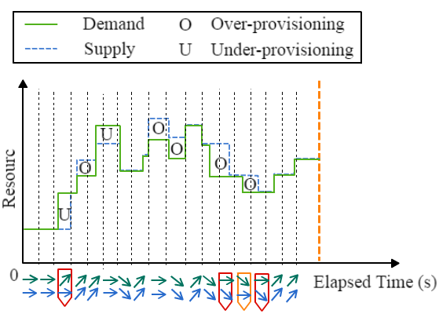
Appendix: Auto scaling metrics (instability)
The fraction of time the supply and demand curves move in opposite directions.
The fraction of time the supply and demand curves move towards each others.

Slide 32
Appendix: Decision Table in Q-Learning based Policy
Different format of State or Action will leads to different Table size.
$Table Size$ = $size of action set ×size of state set$

Slide 33
Appendix: Different Configuration Setting in Determining State

Slide 34
Appendix: Different Configuration Setting in Determining Action

Slide 35
Appendix: Policy Pool Size Impact on Workflow Performance

