Slide 1
An Analysis of Workflow Formalisms for Complex Workflows with Non-Functional Requirements
Erwin van Eyk, MSc student, TU Delft
Alexandru Iosup, Professor of Computer
Science at VU Amsterdam &
Associate Professor of Computer Science at TU Delft
Laurens Versluis Massivizing Computer Systems
@Large research, https://atlarge-research.com
Notes:
Good afternoon ladies and gentlemen. My name is Laurens Versluis and today I will present our work on An Analysis of Workflow Formalisms for Complex Workflows with Non-Functional Requirements. Now this is quite a mouthful, so let’s break it down.

Slide 2
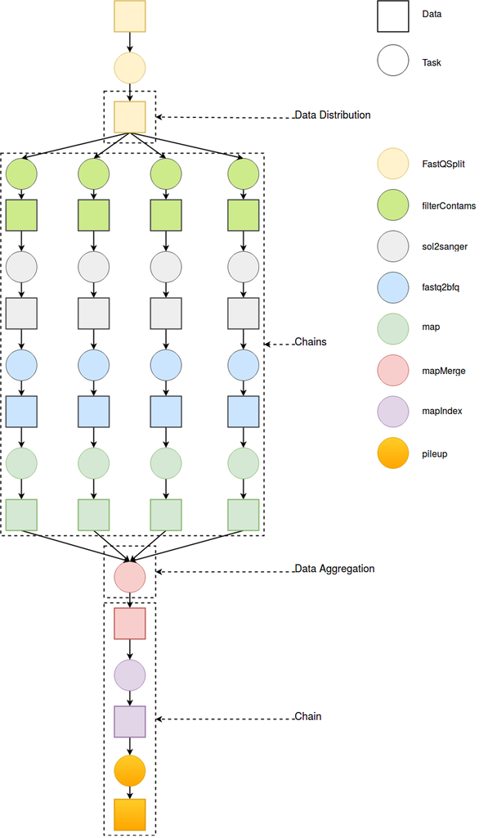
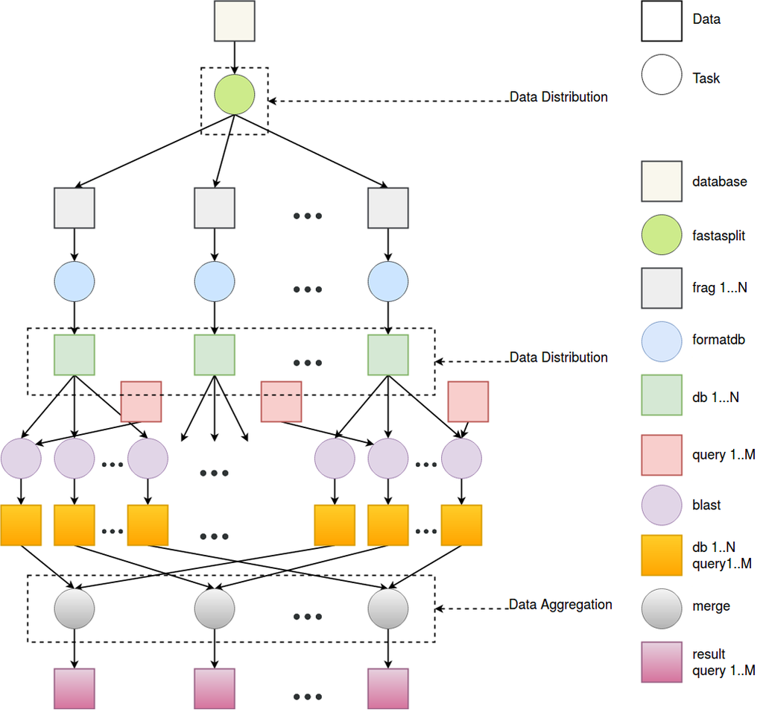
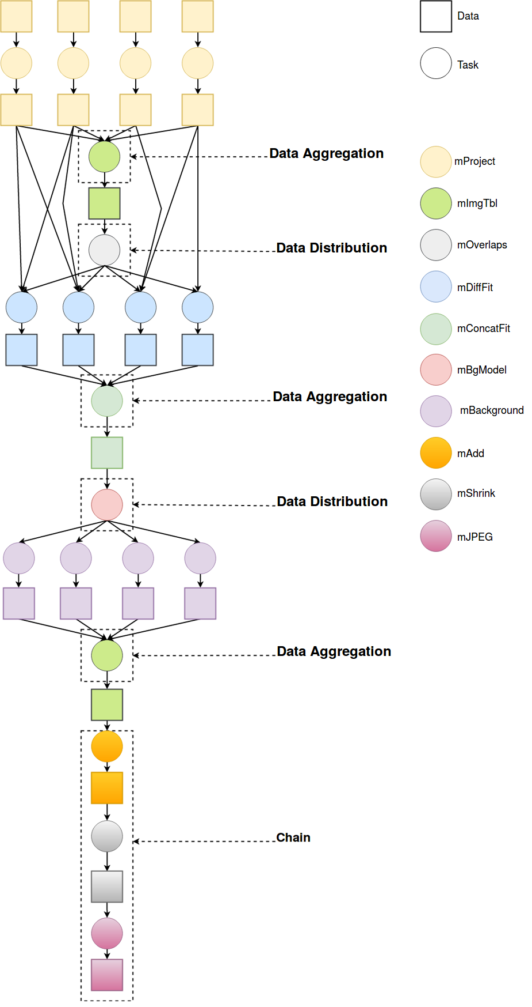
Today's society is increasingly using workflows
Thousands of scientific applications
Represented as workflows
Becoming increasingly more complex
Notes:
In today’s society, thousands of scientific applications such as Blast for protein folding, Epigenomics for cancer research and Montage by Nasa and IPAC for creating images of our univserse are executed each year.
These workflows are becoming increasingly complex, both in size and demands from users.
To be able to reason about them, these applications are represented as a workflow containing computational tasks with data dependencies between them.

Slide 3
Workflows are executed in datacenters
Hundreds of schedulers exist => challenging problem: no “one size fits all”
Scheduler
Notes:
These workflows can then be submitted to the cloud, where they are executed on servers inside a datacenter.
However, something needs to map these workflows to a server. <click> This is done by a scheduler.
A scheduler maps tasks of workflows to servers on which they can be executed.
<click> Currently, there are hundreds of schedulers available, indicating that scheduling these workflows is a challenging task and that definitely no “one size fits all”.
And this makes sense…

Slide 4
Scheduling is hard, also in real life Example: planning a vacation
Dependencies: money, date, (packing) belongings
Agreements: What to visit/do and when?
Constraints: food, accessibility, phobias...
Coordination: meeting at the same place
Complex workflows with dynamic, non-functional requirements (NFRs).
Notes:
Think about planning a vacation with your family or friends.
There are many aspects that come into play here.
First of all there are dependencies such as money: everyone needs to be able to afford it.
You need to make agreements: what are you going to do during your holiday?
Next, there may be constraints present regarding food with someone being a vegetarian, and there needs to be coordination: you need to coordinate where you meet, preferably without people needing to wait for a long period of time if you are staying in different rooms.
This work mainly focuses on these two topics: agreements and constraints in workflows. More concretely we will be talking about Complex workflows with dynamic, non-functional requirements or NFRs.

Slide 5
The current approach
Q: Do we all need a seat at the emergency exit?
Currently, NFRs are set at the workflow level
High performance (e.g. deadlines)
High availability
Privacy/security
Possibly wastes resources
Possibly increases costs
Example: our vacation
A: no, but current approach gives no choice, and we pay for them.
The seats are now marked as occupied as well, cannot be used where actually needed.
Notes:
The current approach is to set NFRs at the workflow level.
Prior work has indicated this may lead to wasting resources and possibly increasing costs.
To illustrate this, let us go back to our vacation example.
Suppose you have to travel by plane and got a rather tall friend. He will definitely need to buy a special ticket for additional space at the emergency exists.
Question: Do we all need a seat at the emergency exits?
Of course we don’t, but with the current approach gives us no choice and pay for them. Moreover, we would occupy them and prevent possibly other tall people from being able to book them.

Slide 6
Goal: obtain a formalism to express NFRs in workflows
Requirements
Allow NFRs at a task-based level
Support dynamic changes
Generic: any NFR on all aspects of a workflow
Additional constructs such as groups
Three possibilities:
Such a formalism already exists
We need to extend an existing formalism
We need to design a formalism ourselves
Notes:
In other words, our goal is to obtain a formalism capable of expressing non-functional requirements in workflows with the following requirements:
First of all, it needs to support NFRs at a task-based level, as just explained using our holiday example.
It also needs to support dynamic changes, perhaps you start a download and if it crashes at start, it would be inconvenient but you don’ t really mind.
However, as time goes by and your download is nearing completion, it would be a pity if it crashes and you would have to download everything again.
A third requirement is that our formalism is generic so that we can specify any non-functional requirement on all aspects of a workflow. This way, we are not constrained to any specific non-functional requirement or run into limitations.
And finally, we would like to add additional constructs such as groups to them.
In total, there are three ways to obtain this formalism:
Either such a formalism already exists, or we need to extend an existing one, or create one ourselves.

Slide 7
Investigating current formalisms
We created a library of six complex workflows
Three with non-functional requirements
Comprehensive survey:
11 conferences, last 5 years: 116 papers
Three most used formalisms:
BPMN
Petri Nets
Directed Acyclic Graphs (DAGs)
Main Finding: None of the three formalisms are capable of expressing (arbitrary) non-functional requirements at a task-based level
Notes:
To investigate if there are formalisms currently in practice that we can use, we first created a library of six complex workflows with three complex workflows having non-functional requirements
Next, we conducted a comprehensive survey to review what is the state of the art in formalisms.
We have looked at the last five years of eleven conferences and checked which papers mention “workflow” in either their abstract or title.
This resulted in 116 papers which we reviewed on which formalism they used.
Reviewing these papers lead to the following three most popular formalisms used in practice: BPMN, Petri nets and Directed Acyclic Graphs.
Our main finding was that none of them were capable of expressing non-functional requirements at a task-based level.
This means that we either need to extend one of these three formalisms or create one ourselves.
So we decided to investigate which of these three formalisms is most suitable to be extended.

Slide 8
Comparing the the three formalisms
Metrics to qualitatively and quantitatively compare the formalisms:
Complexity
Utilization
Support for loops
Current support for NFRs
Popularity
Final outcome: DAGs are most suitable to extend
Notes:
To compare each formalism, we designed five metrics to qualitatively and quantitatively metrics.
One of these metrics is popularity, defined by the amount of papers that we obtained from our survey that explicitly mention the use of a formalism.
The result is that 3 papers explicitly mention BPMN, 5 papers mention Petri nets and 44 mention Directed Acyclic Graphs.

Slide 9
Ongoing work
Extending the formalism of DAGs to fulfill all requirements
Create new provisioning and allocation algorithms based on this new formalism
Compare these algorithms against the state-of-the-art
Notes:
And this bring us to our ongoing work.
Our current focus is extending the formalism of DAGs to fulfill all requirements specified earlier.
Once we obtain our new formalism, we will use it to create new provisioning and allocation algorithms based on this new formalism.
Once that is done, we will compare these new algorithms against the state-of-the-art.

Slide 10
Take-home message
Per-task non-functional requirements can reduce costs and resource usage
Existing popular formalisms for defining workflows do not support dynamic, (arbitrary) non-functional requirements
DAG seems to be the most suitable formalism to extend
Notes:
To wrap up some take-home messages:
Read bullet points + improvise text

Slide 11
An Analysis of Workflow Formalisms for Complex Workflows with Non-Functional Requirements
Erwin van Eyk, MSc student, TU Delft
Alexandru Iosup, Professor of Computer
Science at VU Amsterdam &
Associate Professor of Computer Science at TU Delft
Laurens Versluis Massivizing Computer Systems
@Large research, https://atlarge-research.com
Notes:
Ask for questions.

Slide 12
Metrics used to compare formalisms

Slide 13
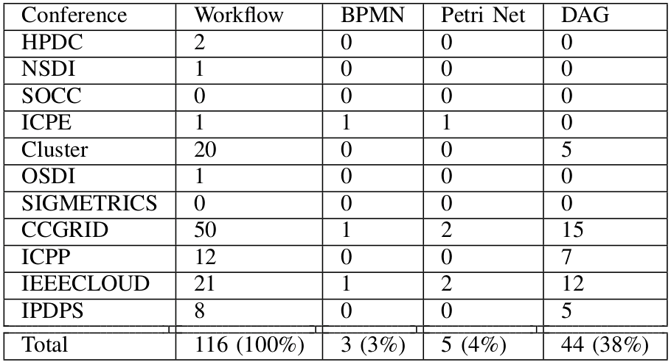
Formalism occurrence per conference

