Slide 1



A Trace-Based Performance Study of Autoscaling Workloads of Workflows in Datacenters
Mihai Neacşu
Alexandru Iosup
Laurens Versluis
Massivizing Computer Systems
@Large research
https://atlarge-research.com
Notes:
Good afternoon ladies and gentlemen, my name is Laurens Versluis. I am a phd student at the vrije universiteit Amsterdam and part of the @Large research group. Today I will present my work on A Trace-based performance study of autoscaling workloads of workflows in datacenters.

Slide 2






@Large Research
Massivizing Computer Systems
20+ researchers across VU Amsterdam and TU Delft
Goal: valorize our research; improve our society
Close collaboration with partners
Notes:
Before we dive into the details, let’s first place this work in a larger context by spending a few words on the @Large research group. @Large Research is a research group that focuses on Massivizing computer systems, which I will cover in a minute.
Our team consists of more than 20 researchers across both the VU Amsterdam and the TU Delft.
One of the goals of the @Large research group is to valorize our research, which means that we would like to have our research being used in practice and improve society.
We achieve this by working closely with our partners such as the SPEC cloud group, the University of Wurzburg and industrial partners such as Google and Intel.

Slide 3





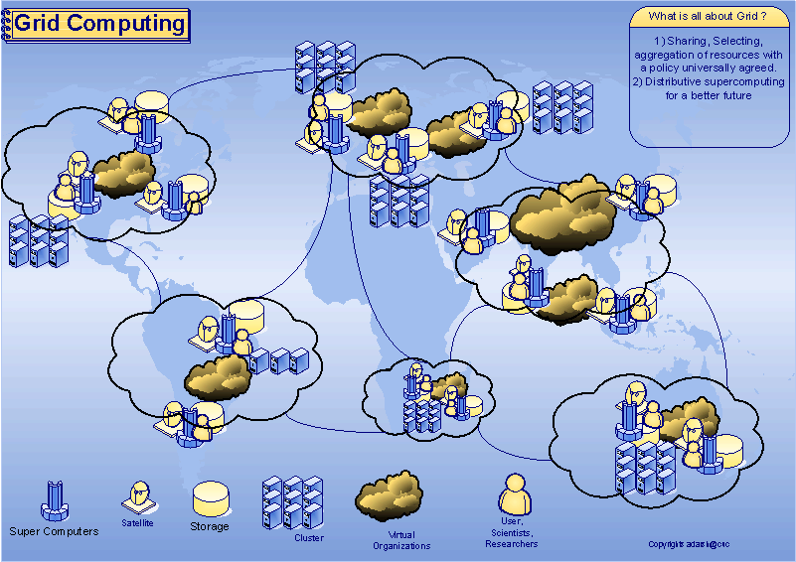





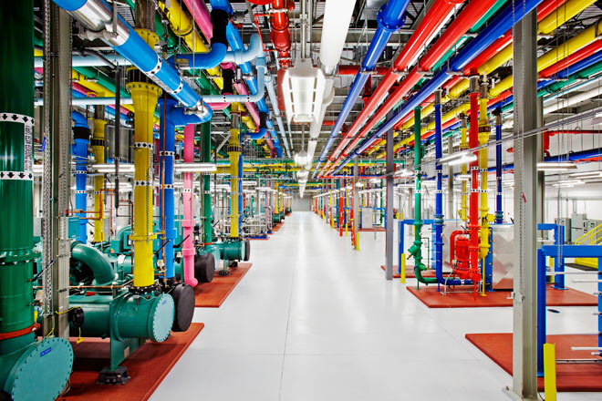

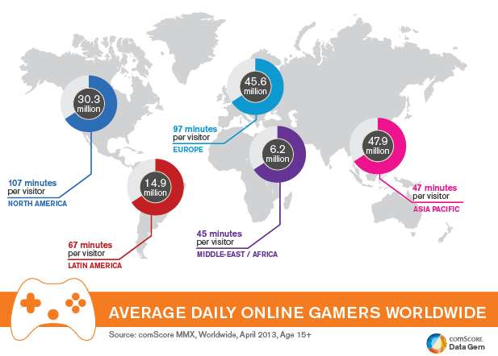




Massivizing Computer Systems
Business Services
Education for Everyone (Online)
Grid Computing
Big Science
Online Gaming
Datacenters
Daily Life
Notes:
Massivizing Computer Systems focuses on all systems and eco-systems that impact society, ranging from education to datacenters and from Big Science to Online gaming.
In this talk, we will mainly focus on these two components; Cloud computing and datacenters. (next slide… Because cloud popularity and its usage….)

Slide 4
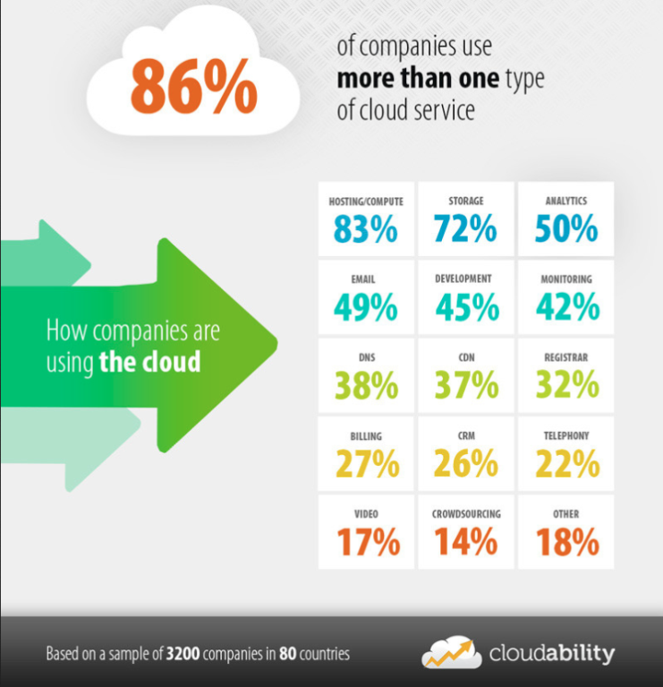
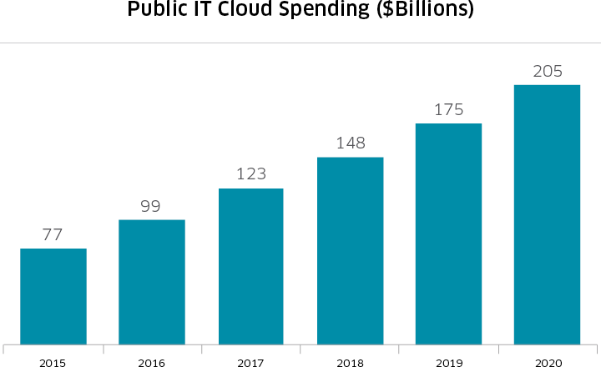
Cloud popularity and usage at all-time high
Surveys: 86% of companies use >1 cloud service, >$200B market by 2020
Effcient resource utilization increasingly important
  Reduce costs for client & provider
  Competitive position for companies
Source: http://business.nasdaq.com/marketinsite/2017/Cloud-Computing-Industry-Report-and-Investment-Case.html
Notes:
Because cloud popularity and its usage are at an all-time high. In a recent survey by Cloudability it was shown that 86% of companies use more than one cloud service. It is also estimated that by 2020 the market for public IT Cloud Spending will surpass 200 billion US Dollars.
This means that resource utilization is becoming increasingly important. A good resource utilization reduced costs for both the cloud provider as well as the client and improves the competitive position of a provider as a result.

Slide 5
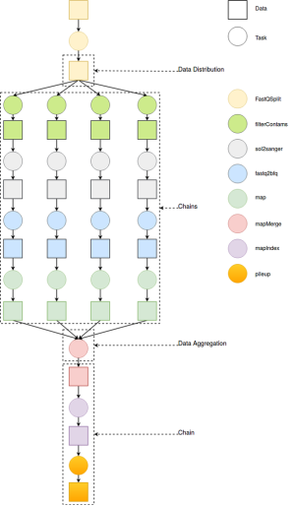
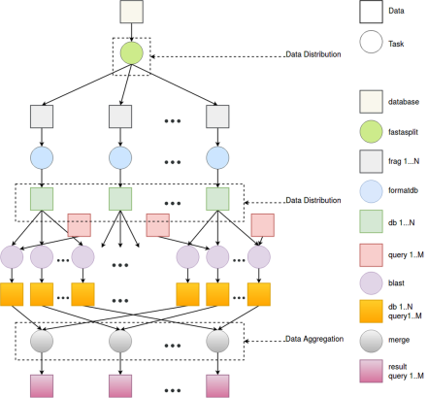

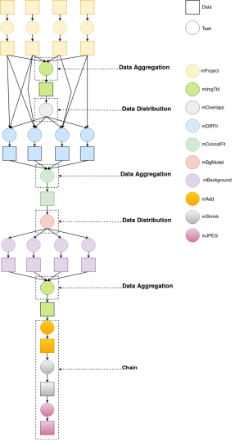
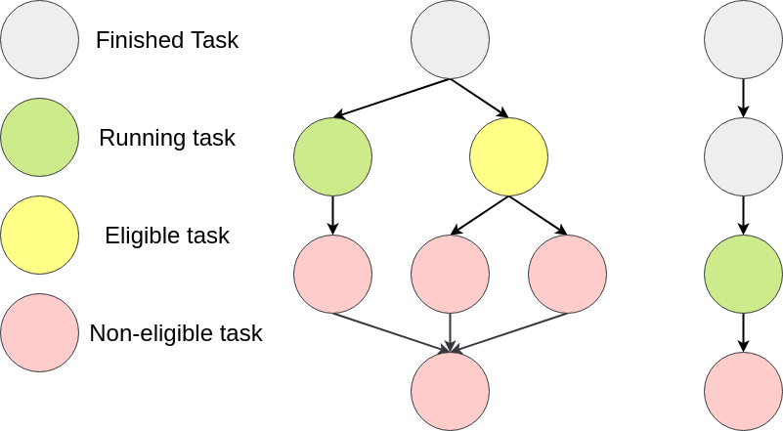



Workflow execution is popular
Workflows = set of tasks with precedence constraints
  Usually represented as a Directed Acyclic Graph (DAG)
  Used to model applications in many domains
Today: thousands of applications in use
Notes:
Workflow execution is also very popular. A workflow is basically a set of tasks with precendence constraints between them. Workflows are usually represented as directed acyclic graphs. They used to model application from many domains for example Blast for protein folding, finding cancer using Epigenomics, creating pictures of our universe or shell that uses workflows in their IoT infrastructure.
All these different workflows have different shapes and sizes and can generate complex workloads of workflows.

Slide 6
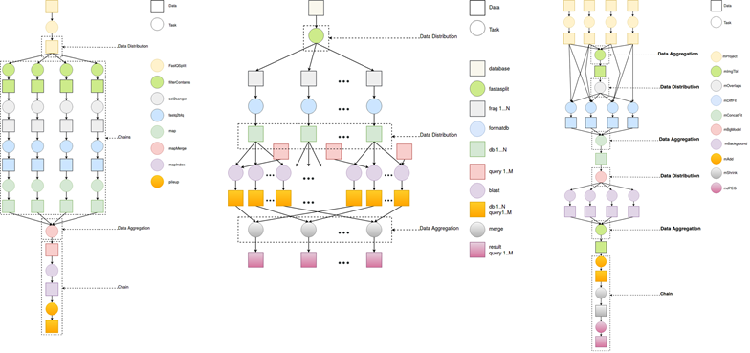

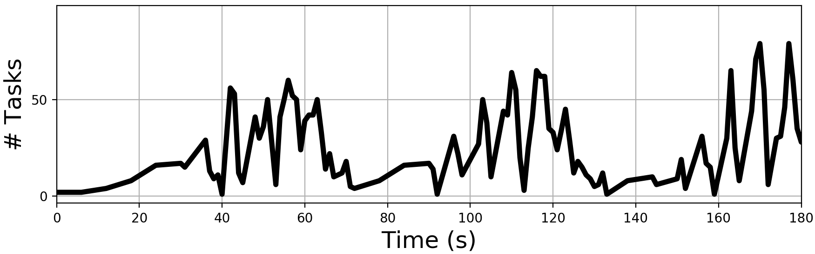
Executing workloads of workflows in the cloud
Workflows are submitted to the cloud, executed in datacenters
Workflow resource demand changes over time due to their complex structures
Non-trivial to estimate incoming tasks and allocate enough resources
How many resources to acquire and when?
Workload of workflows
Notes:
These workflows are submitted to the cloud where they are executed in some datacenter.
However, the resource demand changes continously due to the complex structures of workflows.
This makes it non-trivial to estimate how many tasks are incoming and to allocate enough resources for them.
An example of a workload of workflow is shown on the picture at the bottom right of the slide. This is a part of Shell’s IoT workload. As you can see the pattern of arriving tasks jitters a lot, making it very hard to predict how many tasks will arive.

Slide 7

A problem for cloud providers
Minimize overprovisioning (allocating too many resources)
  Reduce costs
Adhere to the Quality-of-Service (QoS) requirements of the client
  Minimize underprovisioning
Automate this process
  Reduce impact of poor user-estimates
Notes:
And this actually created a problem for cloud providers.
On the one hand they would like to minimize overprovisioning as this reduces costs, but on the other hand they need to adhere to the often strict quality of service requirements of the client, or in other words they must minimize underprovisioning.
Thirdly, cloud providers would like to automate this process to reduce the impact of poor user-estimates.

Slide 8
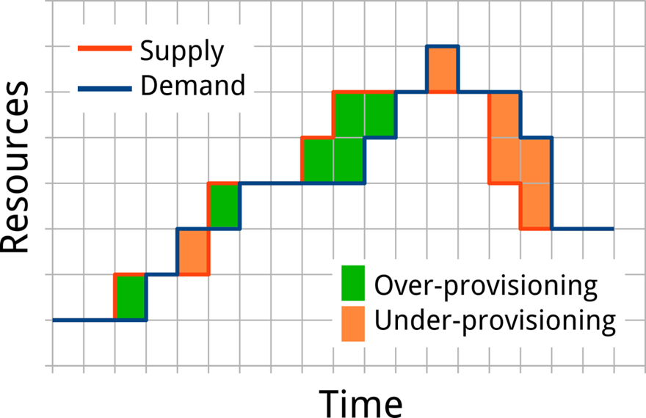
Autoscaler
Scale resources on demand
Forecast resource demand in the near-future
Deal with sudden flash-crowds/peaks
Image source: Ikyushkin et al. “An Experimental Performance Evaluation of Autoscaling Policies for Complex Workflows”, ICPE 2017, best paper nomination
Notes:
The answer to this problem are autoscalers.
An autoscaler scaled resources on demand and can be summarized by the picture below.
In this figure, on the horizontal axis we have time and on the vertical axis the amount of resources.
The blue line denotes the current demand of the system whereas the red line shows the provisioned amount of resources.
If the red line is above the blue line, this means that we are overprovisioning resources. Similarly, if the blue line is above the red line, we are underprovisioning resources.
So ideally we would like the red and blue lines to match.
In other words, autoscalers scale resources on demand and they attempt to forecast resource demand in the near-future.
Some autoscalers are also equiped with policies to deal with suddent flash-crowds or peaks.

Slide 9
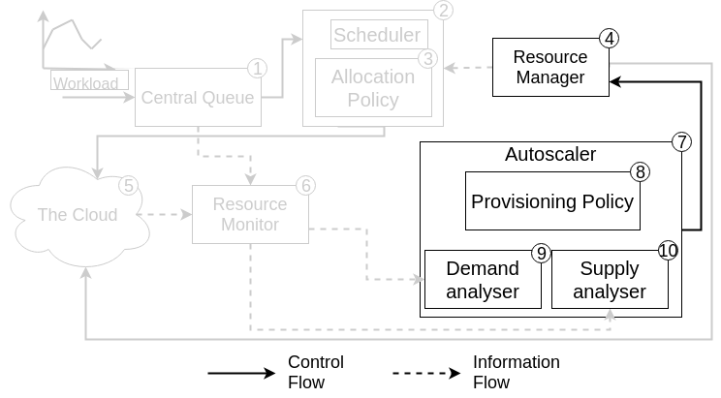
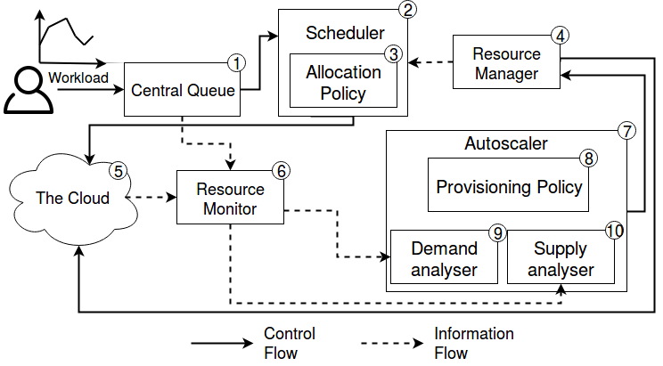
Autoscaler operations
Monitor current workload (9) and available resources (10)
Attempt to predict future utilization (8)
Scale resources up or down according to prediction (4)
Notes:
Overall we identify 10 major components in cloud systems. Now if we want to summarize the actions taken by autoscalers, then we get the following picture.
Autoscalers monitor the current workload through their demand analyzer and the available resources through they supply analyser.
They attempt to predict future utilization through their provisioning policies and scale the amount of available resources through the resource manager.

Slide 10
Two dimensional taxonomy, seven state-of-the-art autoscalers
Timeliness of the Information
How well do autoscalers perform relative to each other?
Long-term
Current/Recent
Server
Hist, Reg, ConPaaS
React, Adapt
Job
Plan
Token
Information Source
Taxonomy by: Ilyushkin et al. “An Experimental Performance Evaluation of Autoscaling Policies for Complex Workflows”, TOMPECS 2017
Notes:
For autoscalers, there are two dimensions that we can consider to divide autoscaler into.
The first one is the information source, which can be either Server or Job.
Server means that information from the server is used to make scaling decisions. Examples of this are the length of the queue, the current throughput, or the amount of resource utilization.
Autoscalers that use Jobs as information source are specifically tailored to workflows and attempt to exploit their structure to make better decisions. In particular, plan constructs partial execution plans and Token attempt to estimate the level of parallelism.
The other dimension is the timliness of information.
Some autoscalers keep a history or track certain information over time, whereas other autoscalers only work with current or very recent information.
Overall, we selected seven state-of-the-art autoscalers that cover these two dimensions well, matching prior work.
And now we ask ourselves the question: how well do autoscalers perform relative to each other?

Slide 11
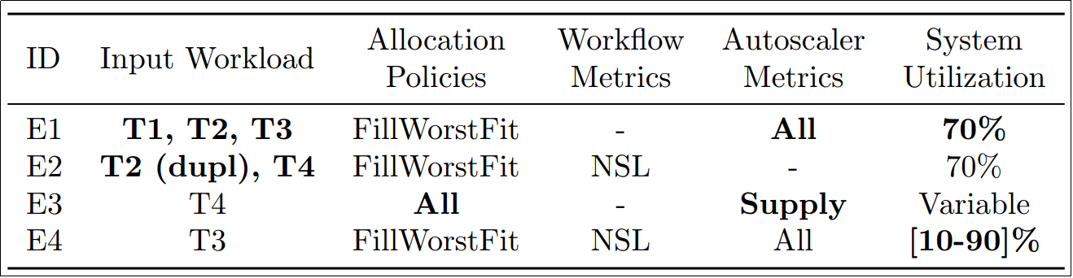
Experimental outline
Four experiments
  Different workload domains (new)
  Bursty workloads (deeper understanding)
  Impact of the allocation policy (new)
  Different resource environments (new)
Notes:
In total, we conducted four different experiments which are summarized in the table below.
In the first experiment, we investigate what the impact is of different workload domains.
In the second experiment, we observe what the impact is of bursty workloads. While this experiment has been conducted before, we attempt to obtain a deeper understanding by using more and more recent metrics than previous work.
The third experiment focuses on the impact allocation policies have on autoscalers. Tasks are assigned to resources according to an allocation policy and in this experiment we focus on how that affects the autoscaler performance.
And finally, in the fourth experiment we changed the system utilization levels between 10% and 90% to observe how well autoscalers work in different resource environments.
Due to time constraints, I will cover the first and third experiment today.

Slide 12
General experimental setup
Extended version of DGSim
Implemented all seven autoscalers
Resources are abstract
Resources are grouped and (de)allocated per cluster
  In all experiments:
Resource monitor receives real-time updates
Idle clusters are deallocated, unless it’s the last one running
The autoscaling interval is set to 30 seconds
Iosup et al. “DGSim: Comparing Grid Resource Management Architectures through Trace-Based Simulation”, Euro-Par 2008
Notes:
The general experimental setup is as followed.
For experiments, we used an extended version of DGSim, which is a discrete event simulator for simulating grid and cloud environments.
We have implemented all seven autoscalers in DGSim to experiment with.
It is also important to note that in this work resources are abstract, meaning we do not differentiate between cores/threads/VMs etc. And are grouped in clusters which are being allocated.
Furthermore, in all experiments the reosurce monitor receives real-time updates and idle clusters are deallocated unless it’s the last one running.
And finally the autoscaling interval, which is the time between two invocations of the autoscaler, is set to 30 seconds.

Slide 13
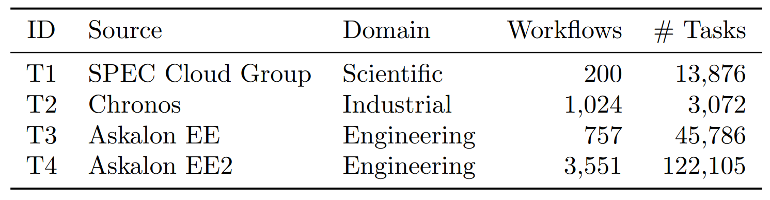



Four distinct traces
Four distinct real-world workload traces
  A workload is a set of workflows (applications)
Medium scale
Notes:
In total, we use four real world workload traces, summarized in the table.
The first on is a scientific workload from the SPEC Cloud Group
The second one is an industrial trace from Shell’s Chronos IoT environment
And the third and fourth are engineernig traces origining from the Askalon grid environemnt.
All these traces have a medium scale size.

Slide 14
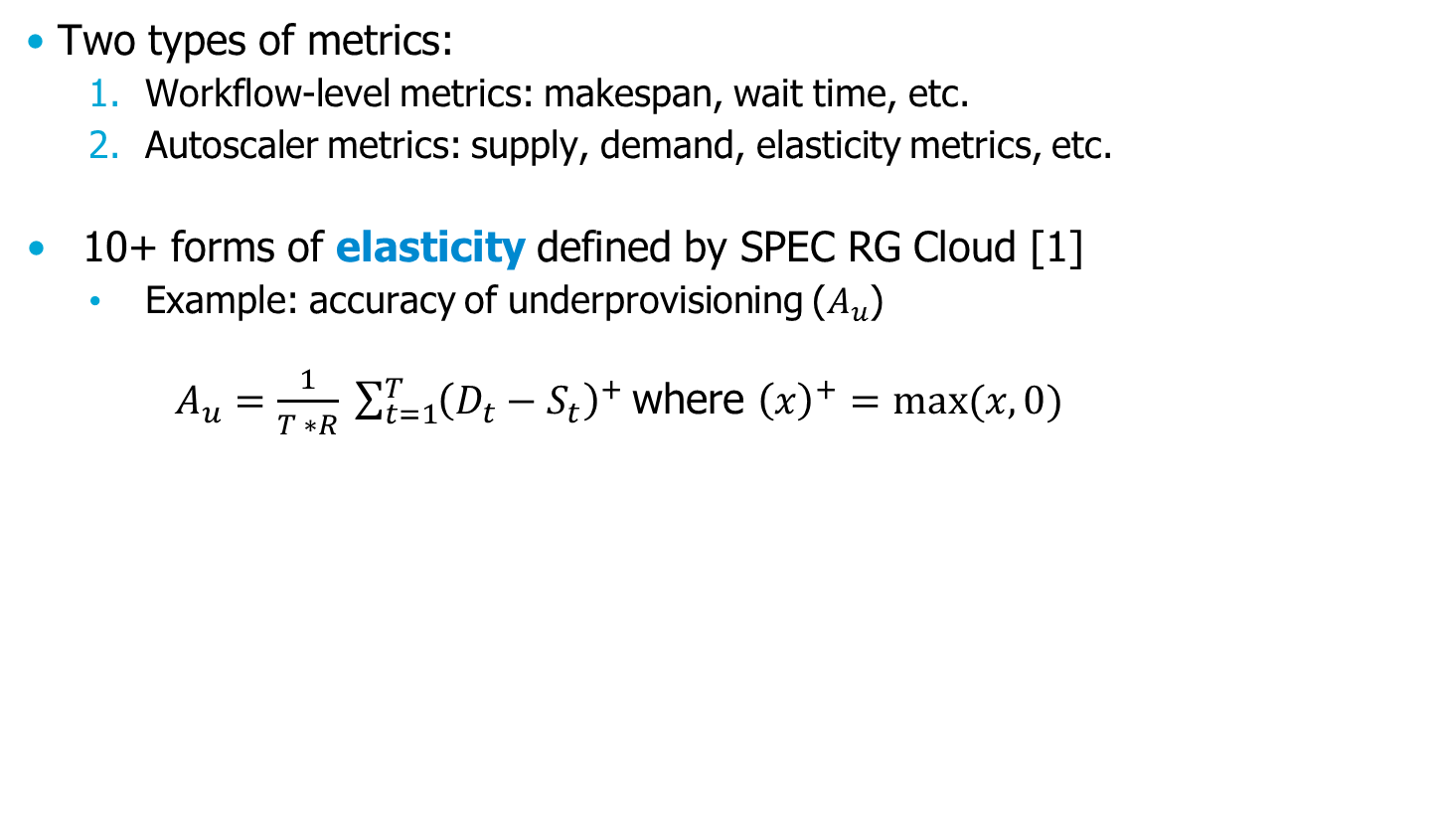
Metrics used in this work
Two types of metrics:
  Workflow-level metrics: makespan, wait time, etc.
  Autoscaler metrics: supply, demand, elasticity metrics, etc.
10+ forms of elasticity defined by SPEC RG Cloud [1]
  Example: accuracy of underprovisioning ($A_{u}$)
  $A_{u}=\frac{1}{T ∗R} \sum_{t=1}^{T}{{\left(D_{t}−S_{t}\right)}^{+} }$where ${\left(x\right)}^{+}=max⁡(x, 0)$
Maximum #resources
Demand not met
[1] Ilyushkin et al. “An Experimental Performance Evaluation of Autoscaling Policies for Complex Workflows”, TOMPECS 2017
Notes:
In this work, we used two types of metrics, the first being workflow-level metrics such as makespan and wait time
And autoscaler metrics such as supply, demand and several elasticity metrics.
In total, we use more than 10 forms of elasticity metrics recently introduced by the SPEC Cloud Group.
One example of such a metric is the accuracy of an autoscaler regarding under and overprovisioning.
Where we measure how many resources that were demanded are not supplied and divide thisby the maximum amount of resources.

Slide 15
Experiment: different workload domains
Investigate the performance of autoscalers while processing workloads of different domains
Prior work focuses on one domain
Three workloads:
  Scientific (T1)
  Industrial (T2)
  Engineering (T3)
Notes:
And this brings us to the first experiment.
Prior work only uses one domain, so in this experiment we are the first to measure the impact of different workload domains on the performance of autoscalers.
In this experiments, we used three different workloads: T1 which is a scientific workload, T2 which is an Industral workload and T3 wich is an engineering workload.

Slide 16

Experimental Setup
Use the Chronos (Shell) industrial resource setup
  70 resources per cluster
The number of clusters available is set to reach 70% resource utilization
  Achievable in supercomputing [1]
Metrics: 12 forms of elasticity defined by SPEC RG Cloud
[1] Jones et al. Scheduling for Parallel Supercomputing:
A Historical Perspective of Achievable Utilization, JSSPP, 1999
Notes:
For this experiment we use the Chronos industrial setup which means that we have 70 resources per cluster.
The number of clusters that are available in total is set to reach 70% resource utilization which is a number we know is achieveable in super comuting.
In this partical experiments we measured 12 forms of elasticity defined by the SPEC RG Cloud group.

Slide 17
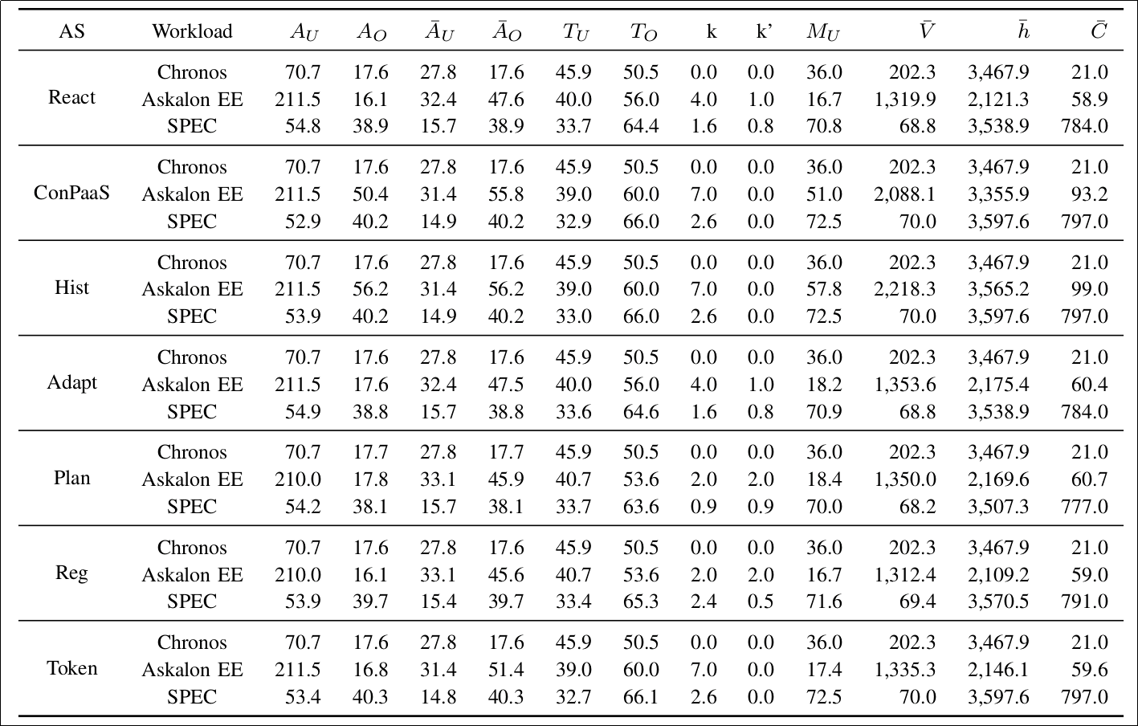
Results: significant differences per domain
For some metrics such as overprovisioning, ConPaaS and Hist perform worse for the EE workload
The autoscaler performance differs significantly per domain and should be carefully benchmarked.
Autoscalers underprovision roughly equally on all workloads
Notes:
And the results look something like this. Now don’t worry, you don’t need to read this table. ☺
What is interesting from these results is that for some metrics such as underprovisioning, all autoscalers perform roughly equal on all workloads.
But if we look at the metric for overprovisioning, then we observe that Conpaas and Hist perform significantly worse than the other autoscalers. This is because the asocalon EE workload features a burst at the start of the workload which biases significantly the history that these two autoscaler keep. Conpaas attempts to forecast resources through linear regression and hist keeps a historgram of past arrivals, thus allocating too many resources.
The main conclusion from this experiemnt is that the workload domain does signficantly affect the performance of autoscalers, and thus one shiould carefully benchmark autoscalers when working with a new workload. TODO: add pop-up blue thing.

Slide 18
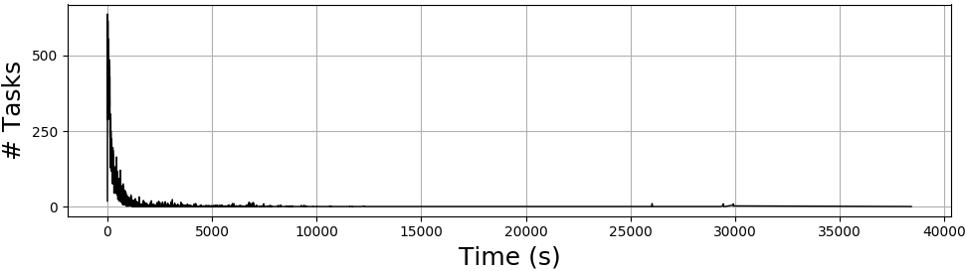
Experiment: bursty workloads
Inspect the performance of autoscalers when handling bursty workloads
Two workloads:
  Scaled version of the Industrial trace (T2) to match T4
  Engineering (T4)
T4 features a one-time burst of ~24,000 tasks in the first minute
Use the Chronos (Shell) industrial setup
  70 resources per cluster
  The number of clusters available is set to reach 70% resource utilization
Metrics
  Cumulative task delay
  Workload makespan (M)

Slide 19
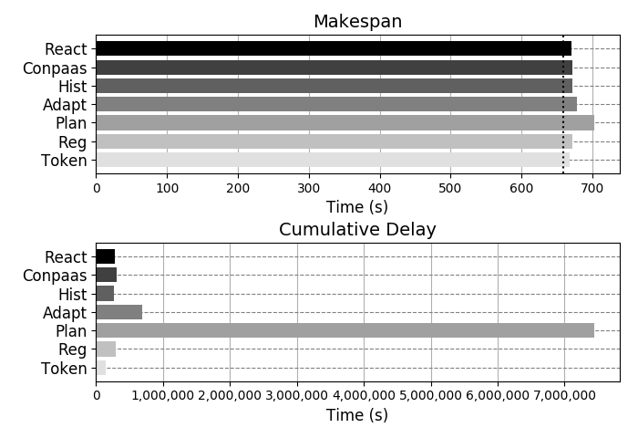
Results
Results for the scaled Industrial workload (T2)
Plan creates two orders of magnitude more cumulative delay.

Slide 20
Experiment: different allocation policies
Inspect the performance of autoscalers using different allocation policies
One workload:
  Industrial (T2)
Three allocation policies
  WorstFit
  FillWorstFit
  BestFit
Use the Chronos (Shell) industrial setup
  70 resources per cluster
The number of clusters available is set to reach 70% resource utilization
Metrics
  Supplied resources
Notes:
This bring us to the second experiment.
In this experiment, we observe how the performance of autoscalers is affected by changing the allocation policy.
In this experiment, we use one workload T4 which is an engineering workload.
In total, we implemented three different allocation policies which I will explain next.
Again, in this experiment we use the Choronos industrial setup which means that we have 70 resources per cluster
And for this experiment we also set the number of available resources to reach 70% resource utilization.
For this experiment, we measure the amount of supplied resources as metric.

Slide 21
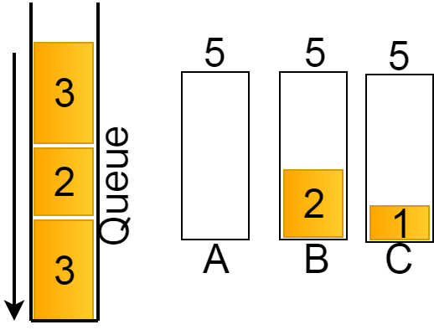
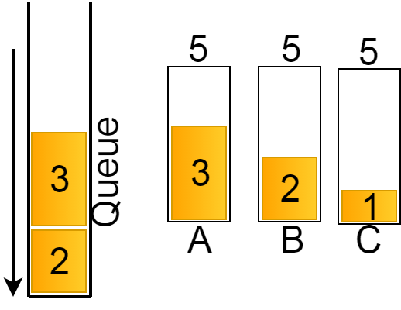
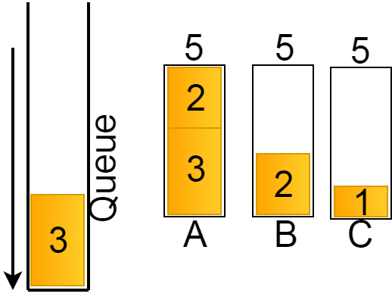
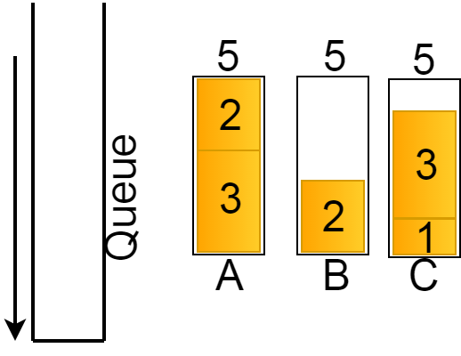
FillWorstFit
Selects a cluster with the most idle resources and put as many tasks in a FCFS-manner on it
1.
2.
3.
4.
Notes:
The first allocation policy that we implemented is FillWorst Fit which selects a cluster with the most idle resources and puts as many tasks on it in a FCFS-Manner on it.
Consider the example below where we have a queue containing three jobs of size 3, 2 and 3 respectively.
There are three clusters each having a capacity of 5 resources. Cluster B already has a load of 2 and C a load of 1.
In this scenario, cluster A has the most idle one and thus is selected. Next, the first job with size 3 is placed on this cluster.
The next task also fits on Cluster A so it is also placed there.
Now that the next job no longer fits on A, the next most idle cluster is selected wich is cluster C, and the last task is placed on it.

Slide 22
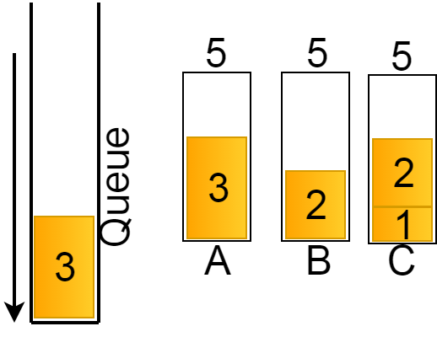
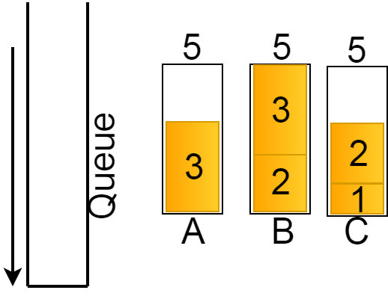
WorstFit
Select per task (FCFS) a cluster with the most idle resources
1.
2.
3.
4.
Notes:
WorstFit is similar to FillworstFit, but differs in the fact that between every task placement, it selects the most idle cluster.
To illustrate this, we start with the same scenario. So again, we have a queue of 3 tasks havng sized 3, 2, and 3 respectively.
Now cluster A is again the most idle, so it will be selected and the first task assigned to it.
Now for the next job, Cluster C is the most idle so the next task is allocated to cluster C.
Finally, cluster B now has the most idle resources and thus will receive the last task.

Slide 23
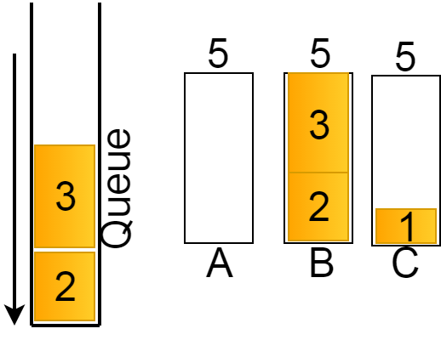
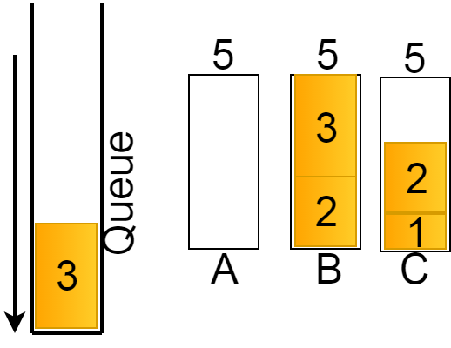

BestFit
Select per task (FCFS) a cluster with the least idle resources where the task still fits
1.
2.
3.
4.
Notes:
Finally, we have the BestFit policy which selects per task in a first come first serve manner and assigns them to the cluster with the least idle resources where the task stil fits.
To illustrate this we yet again start with the same setup. Now this policy selects cluster B as it’s the least idle and assigns the first task to it. Next, it will select Cluster C and assigned the second task to it. Finally, the last task is placed on cluster A as the other clusters do not have enough resources to execute it.

Slide 24
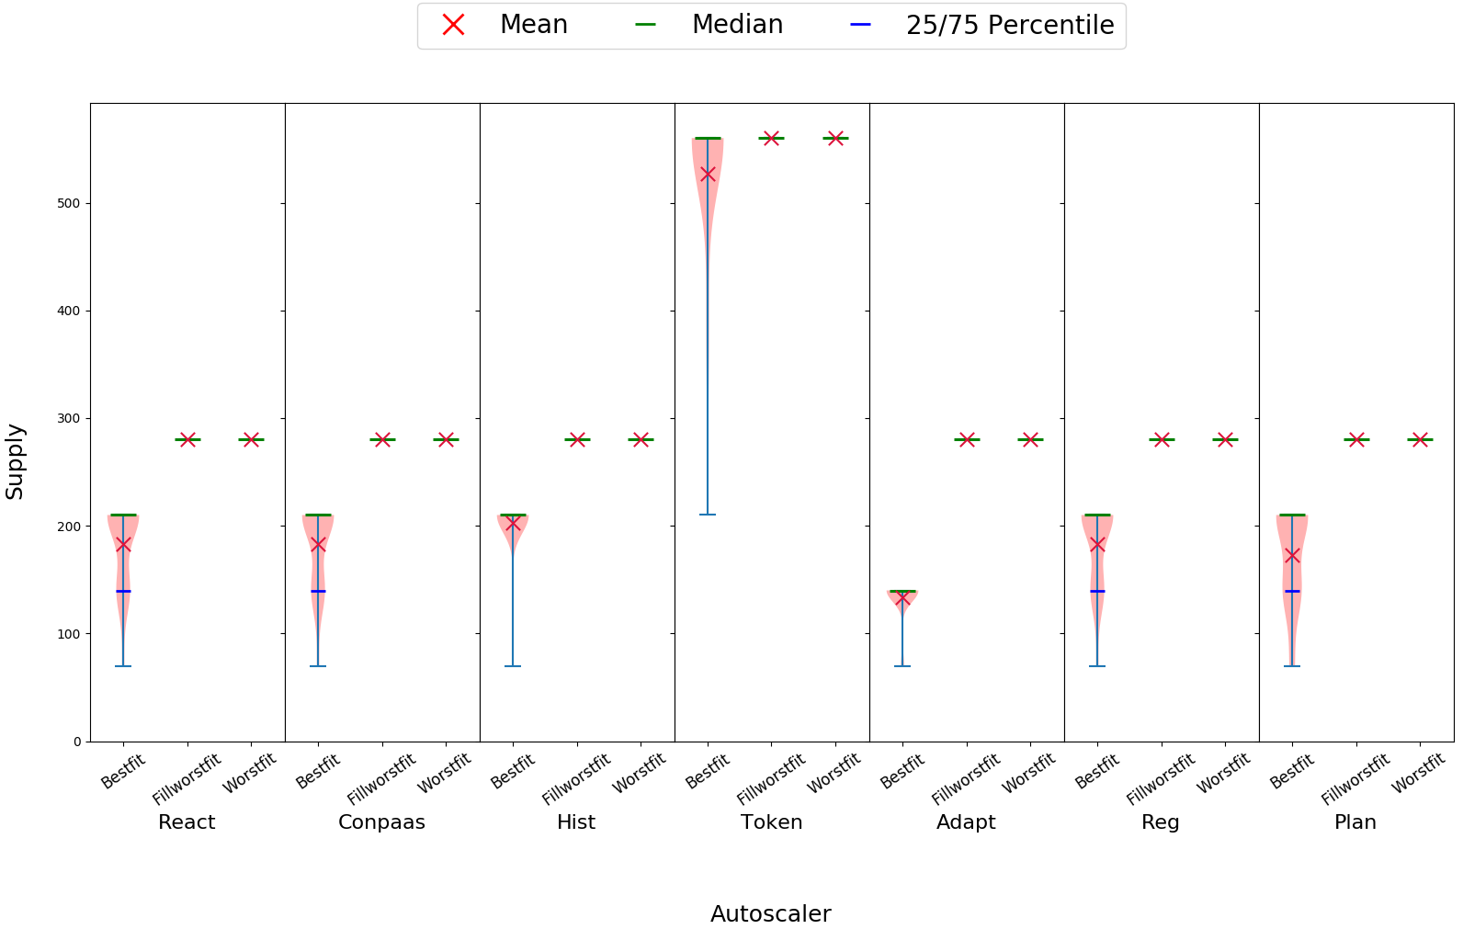
Results
Token overestimates the level of parallelism and oversupplies
BestFit has a significant better performance than the other two policies
The allocation policy has a direct impact on the performance of an autoscaler.
This suggests co-designing allocation and provisioning policies.
Notes:
The results of the experiment are as follows.
Now this is a very dense figure so allow me to break it down.
On the horizontal axis we have seven different groups, one per autoscaler. On the vertical axis we show the supply in amount of resource provided. Per group we show a violin plot per allocation policy, thus three per group. Per violin plot, we show the distribution of the supplied resources as well as a red cross, denoting the mean, a greed bar denoting the median and two bars for the 25th and 75th percentiles.
The first observation that we can make is that Token has a significant higher supply than the other autoscalers. This is because it overestimated the level of parallelism and oversupplies.
Add callout why fillworstfit and worstfit are at 280 (because idle clusters receive 1 task continuously and cannot be deallocted).

Slide 25
Experiment: different resource environments
Inspect the performance of autoscalers while running in different resource environments
One workload:
  Engineering (T4)
Three allocation policies
  WorstFit
  FillWorstFit
  BestFit
Use the Chronos (Shell) industrial setup
  70 resources per cluster
  The number of clusters available is set to reach 70% resource utilization
Metrics
  Cumulative task delay
  Normalized Schedule length (NSL)
  Workload makespan (M)

Slide 26
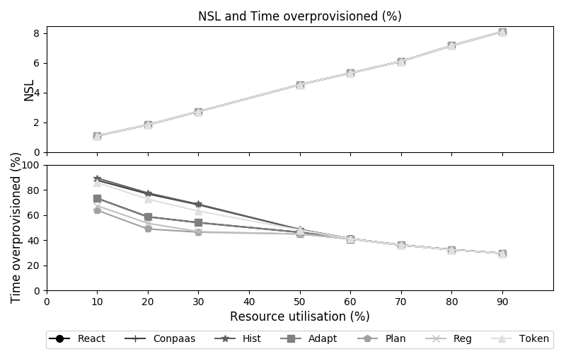
Results
Hist, ConPaaS and Token overprovision more at lower resource utilizations while yielding no NSL benefit.

Slide 27
Conclusion and future work
We compared seven state-of-the-art autoscalers using four distinct traces
We conducted four experiments:
The performance differs significantly per application domain
The allocation policy has a direct impact on performance
All autoscalers perform similar on bursty workloads in terms of NSL
Some autoscalers overprovision more while yielding no better NSL
Future work:
Study the impact of heterogeneity
Apply several cost metrics by using e.g. cost models
Experiment with job and task migrations
Improve our simulations by including e.g. resource boot-up times
Include more autoscalers that were recently introduced
Notes:
The performance differs significantly per application domain
All autoscalers perform similar on bursty workloads in terms of NSL
The allocation policy has a direct impact on performance
Suggests to co-design allocation and provision policies
Some autoscalers overprovision more while yielding no better NSL

Slide 28

A Trace-Based Performance Study of Autoscaling Workloads of Workflows in Datacenters
Mihai Neacşu
Alexandru Iosup
Laurens Versluis
Massivizing Computer Systems
@Large research
https://atlarge-research.com

Slide 29
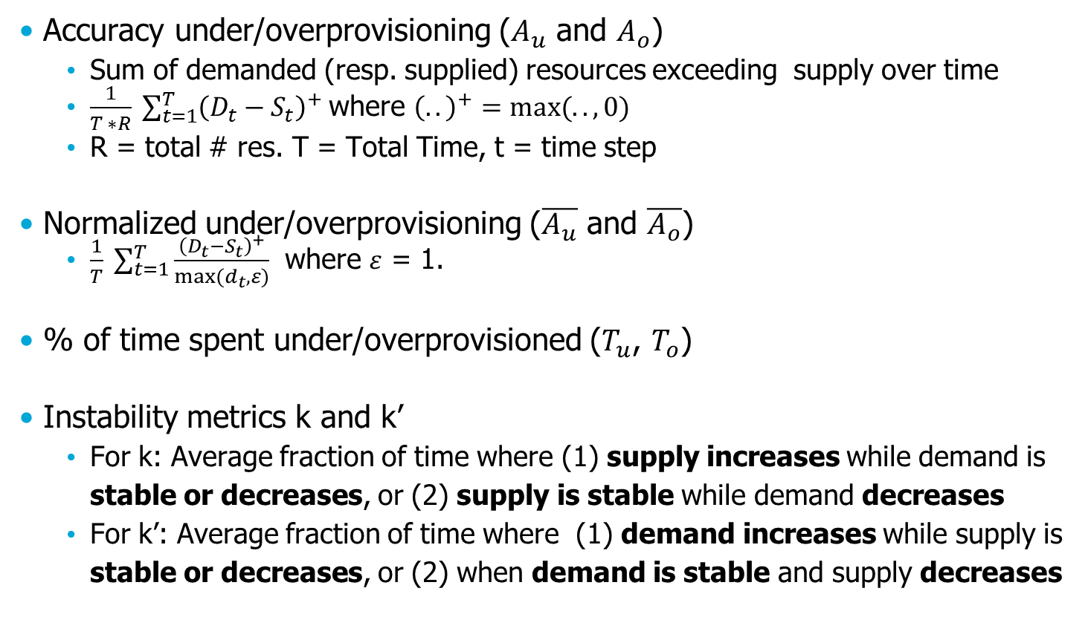
SPEC RG Cloud Elasticity Metrics 1/2
Accuracy under/overprovisioning ($A_{u}$ and $A_{o}$)
  Sum of demanded (resp. supplied) resources exceeding supply over time
  $\frac{1}{T ∗R} \sum_{t=1}^{T}{{\left(D_{t}−S_{t}\right)}^{+} }$where ${\left(..\right)}^{+}=max⁡(.., 0)$
  R = total # res. T = Total Time, t = time step
Normalized under/overprovisioning ($\overline{A_{u}}$ and $\overline{A_{o}}$)
  $\frac{1}{T} \sum_{t=1}^{T}{\frac{{\left(D_{t}−S_{t}\right)}^{+}}{max⁡(d_{t}, ε)} }$ where $ε$ = 1.
% of time spent under/overprovisioned ($T_{u}$, $T_{o}$)
Instability metrics k and k’
  For k: Average fraction of time where (1) supply increases while demand is stable or decreases, or (2) supply is stable while demand decreases
  For k’: Average fraction of time where (1) demand increases while supply is stable or decreases, or (2) when demand is stable and supply decreases

Slide 30

SPEC RG Cloud Elasticity Metrics 2/2
$\overline{C}$ = Charged CPU hours (VMs)
$\overline{V}$ = Average number of resources = $\frac{1}{T} \sum_{t=1}^{T}{s_{t} }$
$\overline{h}$ = Effective used CPU hours
$M_{u}$ = Average idle resources = ($\frac{1}{T ∗R}) \sum_{t=1}^{T}{u_{t}}$
  $u_{t}$ = amount of idle resources at timestamp t

Slide 31
Where our work differs
Lesch et al. “FOX: Cost-Awareness for Autonomic Resource Management in Public Clouds” (ICPE 2018)
  Uses 3/7 autoscalers (React, Reg, and Adapt)
  Focuses on reducing cost and SLO-violations using introduced middleware
Rapid Testing of IaaS Resource Management Algorithms via Cloud Middleware Simulation (ICPE 2018)
  Uses 2/7 autoscalers (React and Reg)
  Focuses on constructing simulation models at runtime
  Uses synthetic workloads
Ilyushkin et al. “An Experimental Performance Evaluation ofAutoscalers for Complex Workflows” (TOMPECS 2017)
  Uses 7/7 autoscalers
  Uses two synthetic workloads
  Focuses on introduced elasticity metrics

Slide 32
The seven autoscalers (in a nutshell)
Reg
  Employs a predictive component using second-order regression
Adapt
  Predicts workload based on the slope of the curve of monitored load
Hist
  Predicts workload based on an hour-based histogram of past load
React
  Scales resources when a certain threshold has been reached
ConPaaS
  Scales resource based on past observed throughput. Uses several time series analysis techniques such as Linear Regression
Token
  Estimates the level of parallelism and allocates resources based on this number
Plan
  Constructs partial execution plans for running and eligible jobs by exploiting workflow structure and estimating task runtimes

