Slide 1
Yardstick
A Benchmark for Minecraft-like Services
Jerom van der Sar
Jesse Donkervliet
Alexandru Iosup
Contact: opencraft@atlarge-research.com www.atlarge-research.com/opencraft

Slide 2
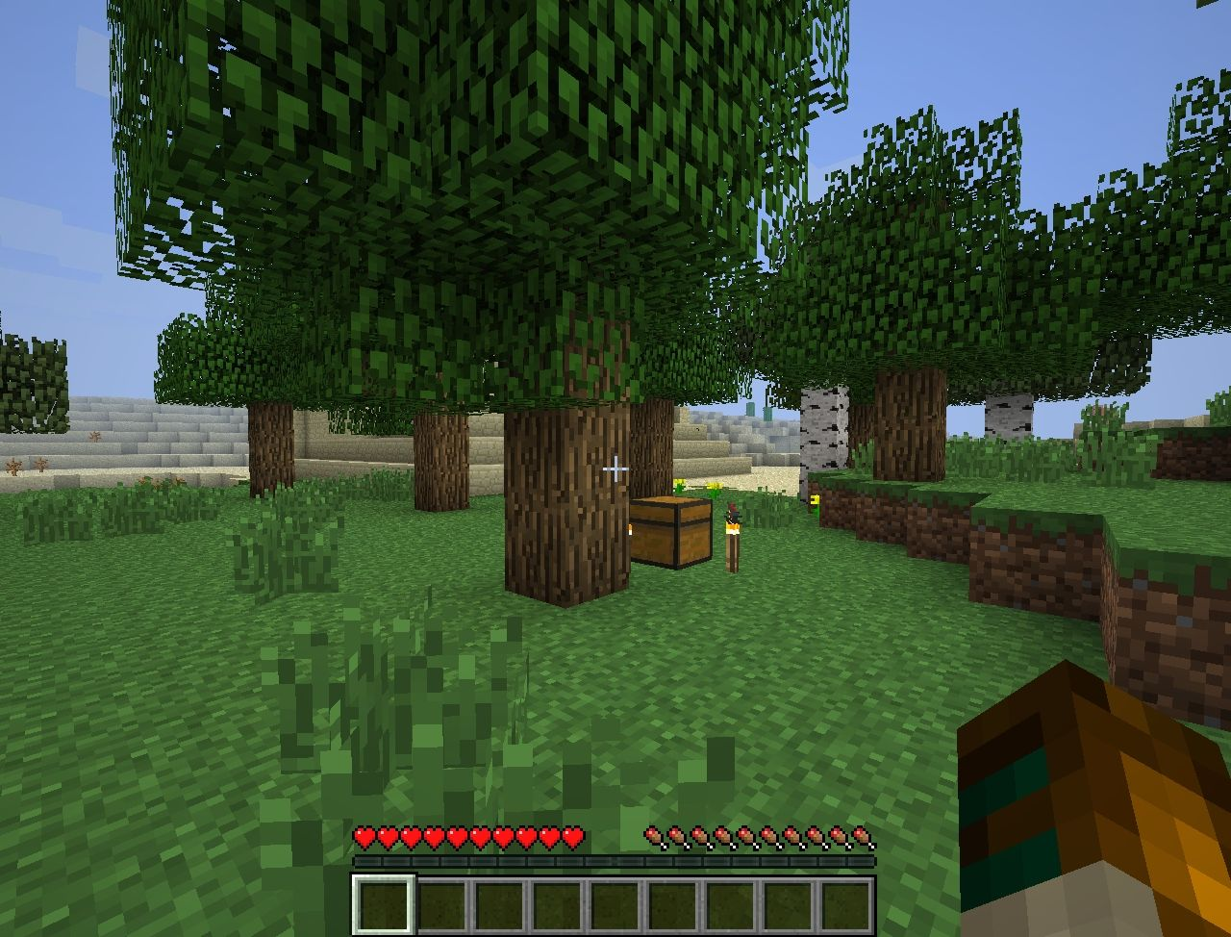
Minecraft = Block-based Online Game
Blocks
© Mojang and Microsoft
Notes:
Talk about Minecraft
Differences between MC and other games
Introduce: example awesomeness
Hint about computation: dynamic pathfinding in Minecraft

Slide 3
Minecraft = Most Popular Block-based Online-game
50 million active users
Over 100 million sales worldwide
53,000 daily
20 since this presentation started
Mojang valued at $1.8 billion
Microsoft bought for $2.5 billion
Sources: techspot.com

Slide 4
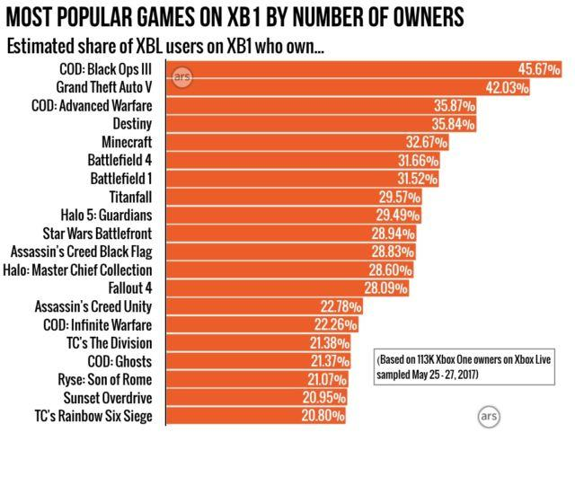
Minecraft = Most Popular Block-based Online Virtual Environment
Also: Only game in top-20 by sales for Nintendo Wii/Switch
Source: arstechnica.com
Notes:
Number 5 most bought game on Xbox 1. One in three Xbox users have Minecraft.

Slide 5
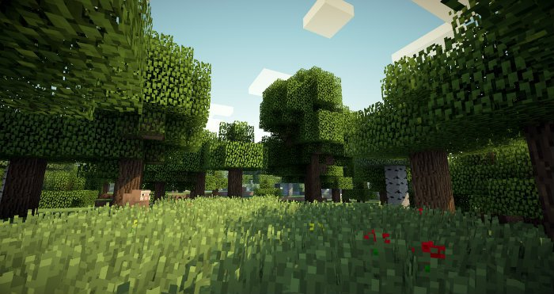
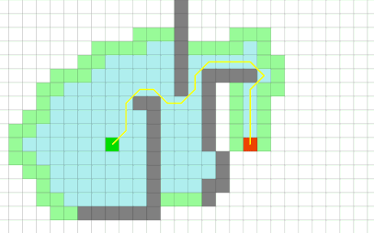
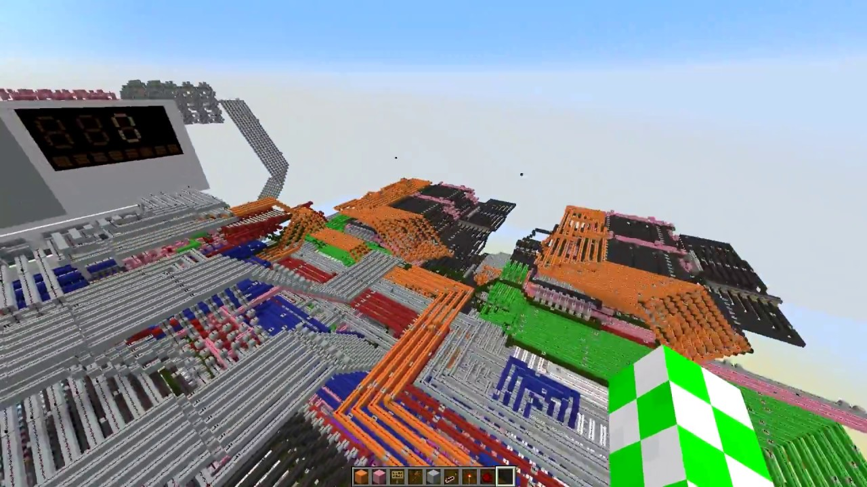
Minecraft = Uniquely Modifiable Online Game
1. Terrain is completely modifiable
No baked lighting / light maps
Unstable 3D pathfinding
No static maps ⇒ More network
2. Terrain influences computation
Redstone ⇒ Computation in MC
Physics ⇒ Falling blocks, liquid flow, arrows, etc.
Sources:
curseforge.com,
codingame.com,
minecraftsix.com

Slide 6
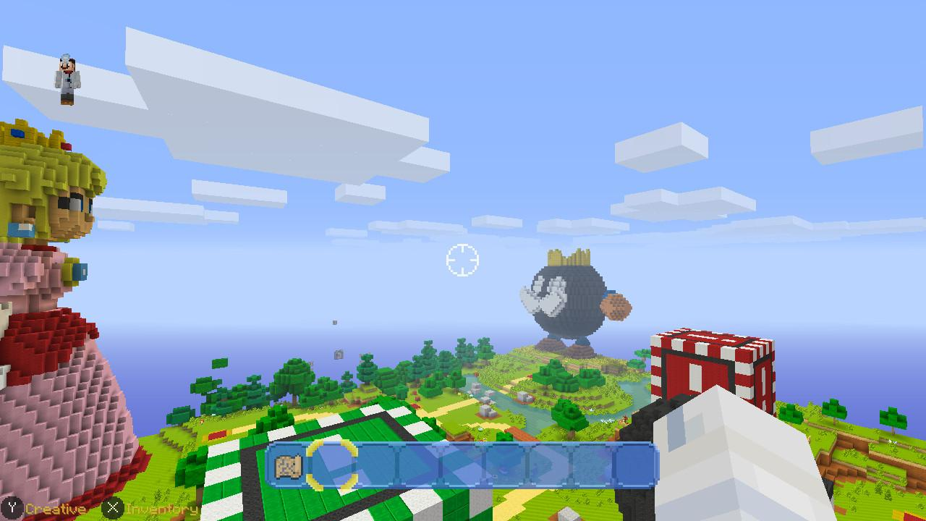
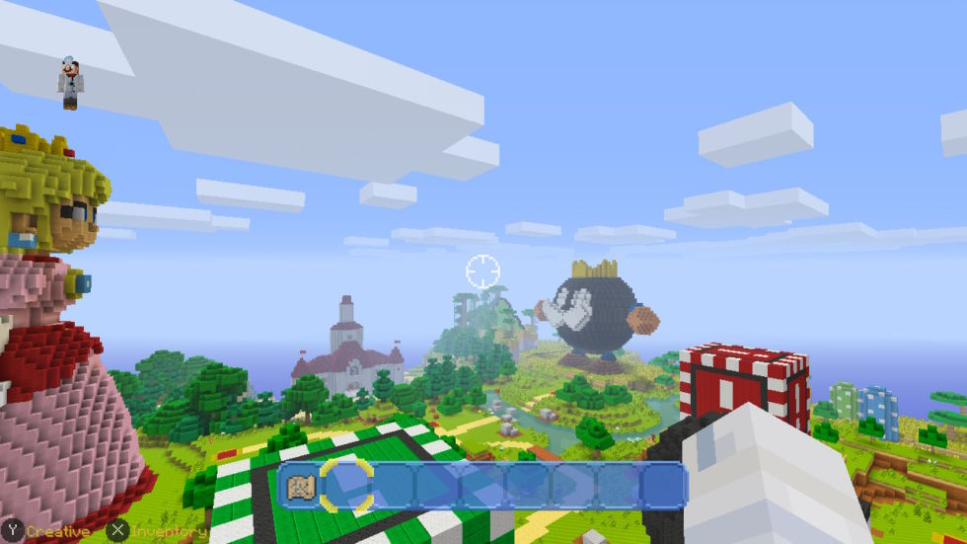
Minecraft = Subject to Performance Optimization
Undocked (Battery)
Docked (A/C)
Minecraft on Nintendo Switch: docked (A/C) vs undocked (Battery)
Source: techspot.com
Notes:
Minecraft on Wii switch: docked vs undocked.

Slide 7
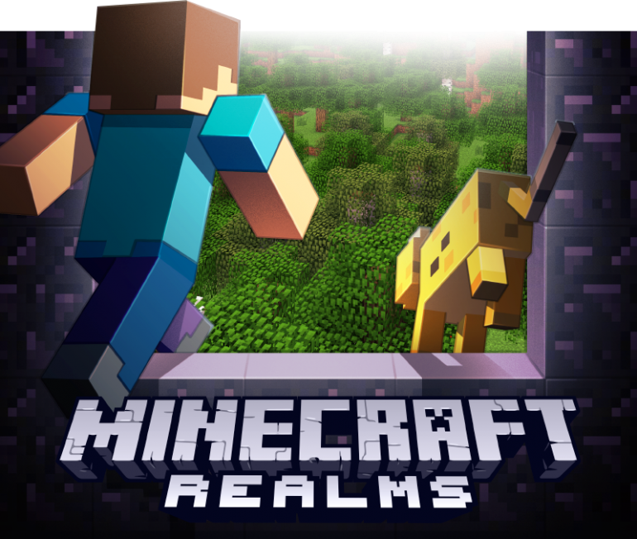
Community is booming
Independently hosts 50k+ servers
10+ server distributions
38k custom modules
Minecraft servers:
2. Minecraft offered ‘as a Service’
Unofficially: 50+ providers
Officially: Mojang Realms
Sources:
bstats.org,
curseforge.com

Slide 8
Which Minecraft-like Server Performs ‘Best’?
Community is booming
Independently hosts 50k+ servers
10+ server distributions
38k custom modules
Minecraft servers:
Q: How to evaluate the performance of Minecraft-like servers?
2. Minecraft offered ‘as a Service’
Unofficially: 50+ providers
Officially: Mojang Realms
Q: How to make Minecraft-like games scale to millions?
Sources:
bstats.org,
curseforge.com

Slide 9
Opencraft: An Umbrella Project
Yardstick
A benchmark for Minecraft-like services
Meerkat
A prototype to explore novel scalability techniques for Minecraft
Notes:
Note: Opencraft only _starts_ with these two subprojects.

Slide 10
Exploring Minecraft-like Services

Slide 11
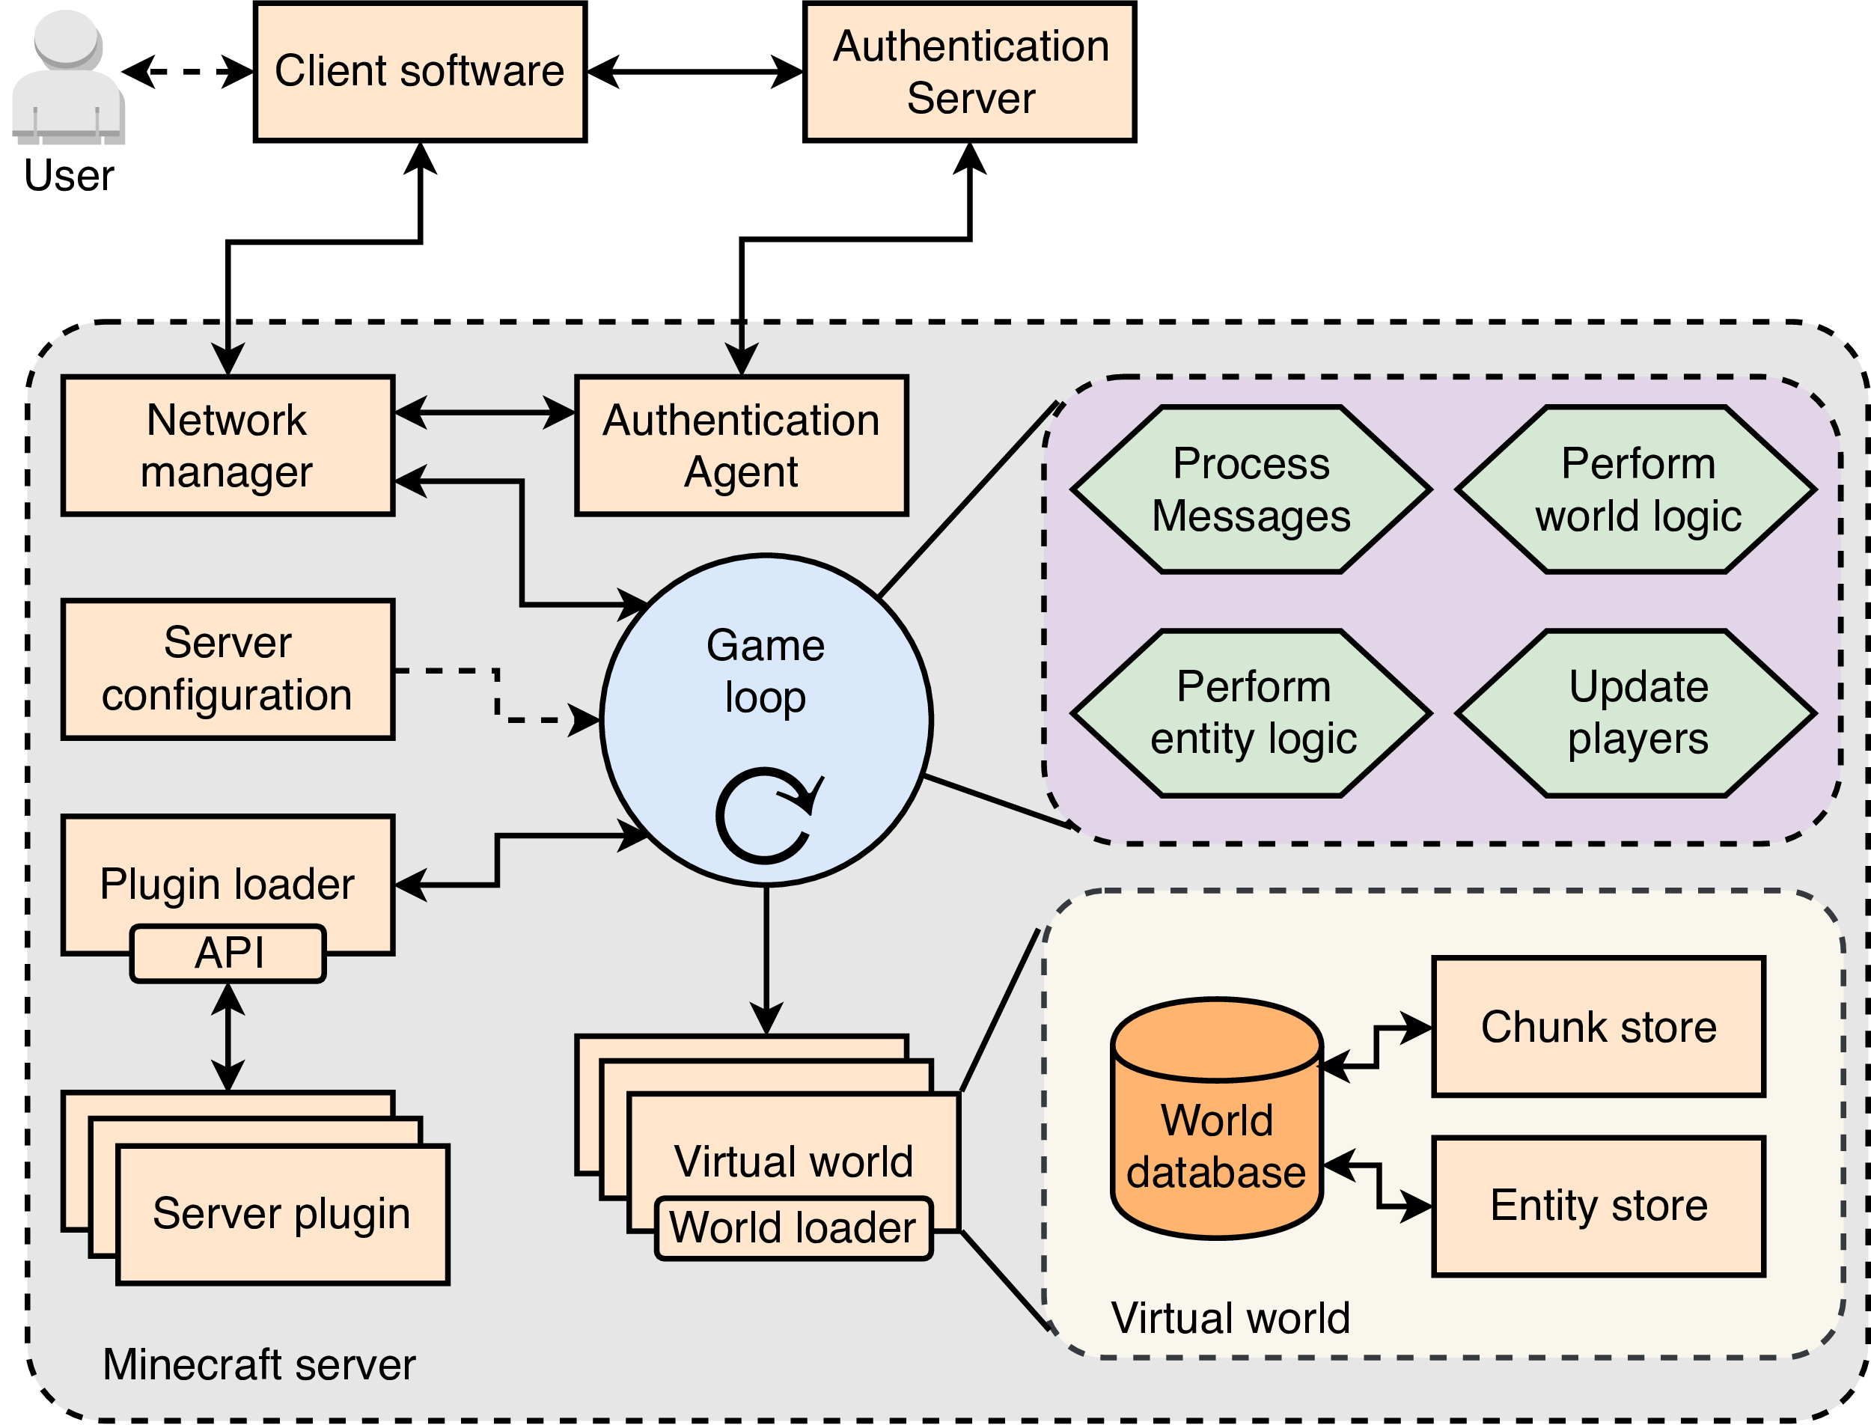
Intermezzo: A System Model for Minecraft-like Services

Slide 12
Intermezzo: Game Loops
Spent processing new game state
Thread sleep

Slide 13
Intermezzo: Game Loops
Spent processing new game state
Thread sleep
Q: How to measure performance?
A: Define a metric!

Slide 14
Intermezzo: Game Loops

Slide 15
Yardstick
A Benchmark for Minecraft-like Services

Slide 16
Yardstick: Goals
Performance evaluation tool for Minecraft-like games
Goals:
Benchmark & compare server performance: Which architecture and/or implementation for Minecraft-like games performs ‘best’?
Analyze server performance: Identify bottlenecks and performance issues

Slide 17
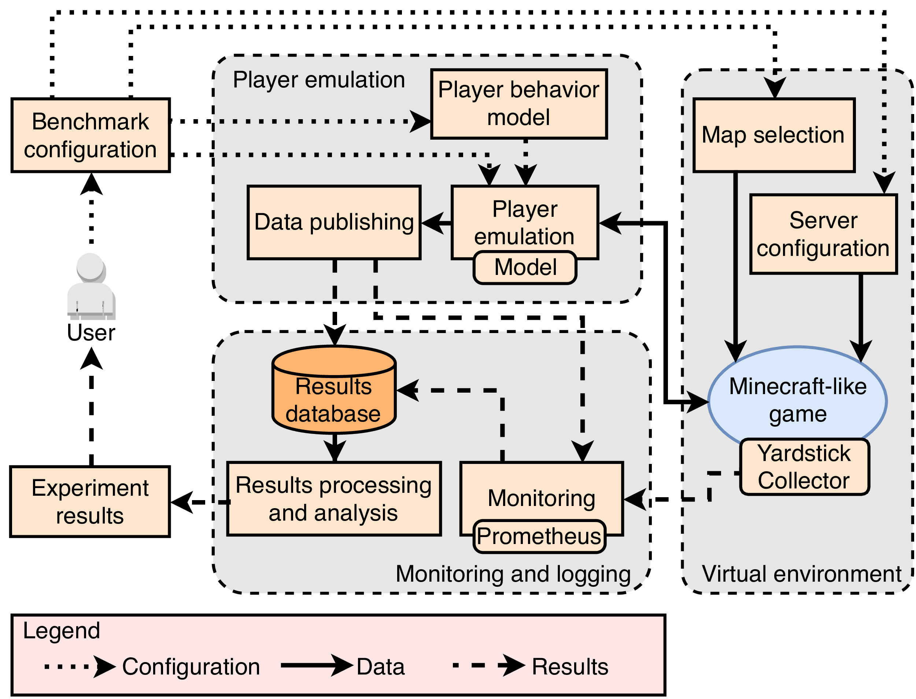
Yardstick: Design Overview
Notes:
Talk about
Player emulation
Vendorized Minecraft server
Results processing and virtual environment

Slide 18
Yardstick: Experimental Setup
Experiments performed on DAS-5
Experimental infrastructure in NL
7x bare-metal machines with
Intel E5-2630v3 CPUs
64GB RAM
Infiniband networking
1x Minecraft, 1x Monitoring, 5x Yardstick emulator
Workload consist of players that alternate between traveling (walking a large distance)
and interacting (walking many short distances)

Slide 19
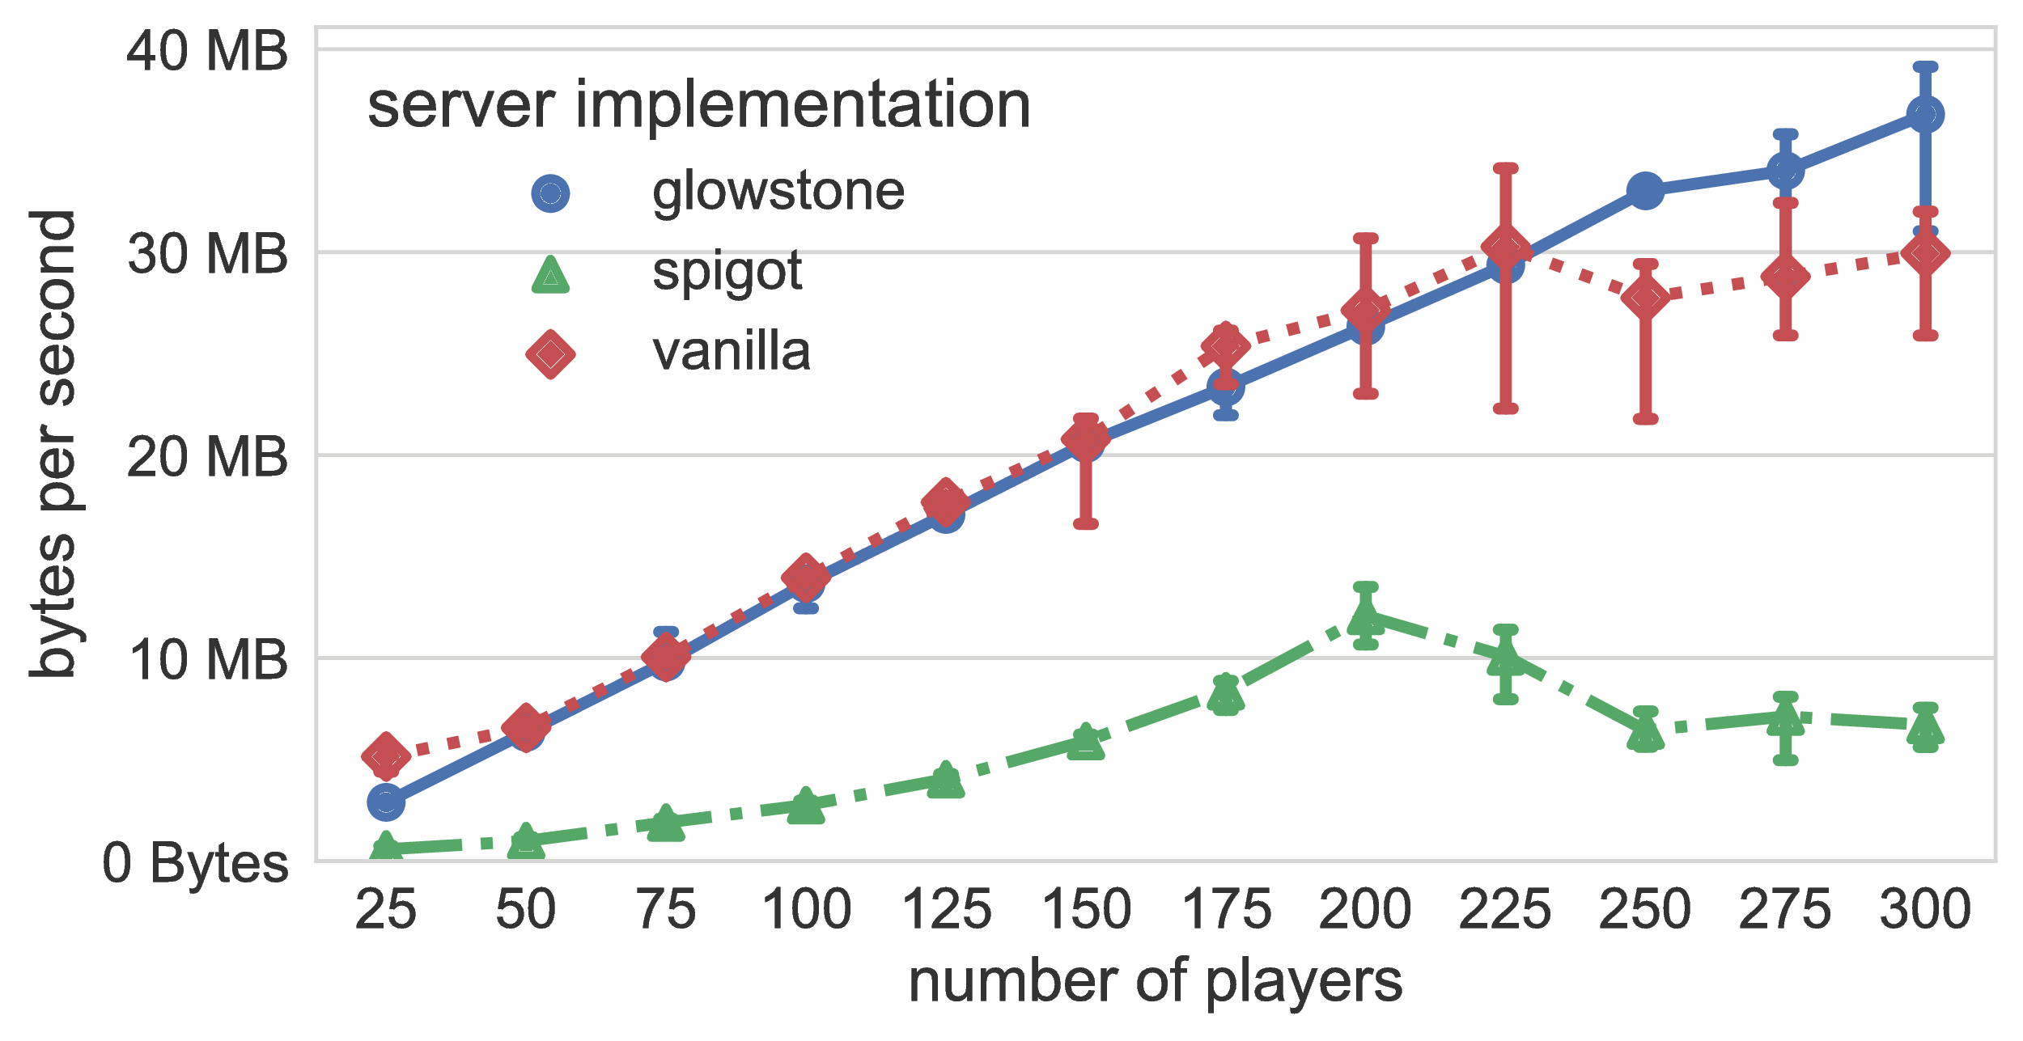
Yardstick: Network traffic (out)
≈ 160 Mbps outgoing
Notes:
Talk about
Player emulation
Vendorized Minecraft server
Results processing and virtual environment

Slide 20
Yardstick: Network traffic (out)
≈ 160 Mbps outgoing
Minecraft-like services use a lot of network traffic
Notes:
Talk about
Player emulation
Vendorized Minecraft server
Results processing and virtual environment

Slide 21
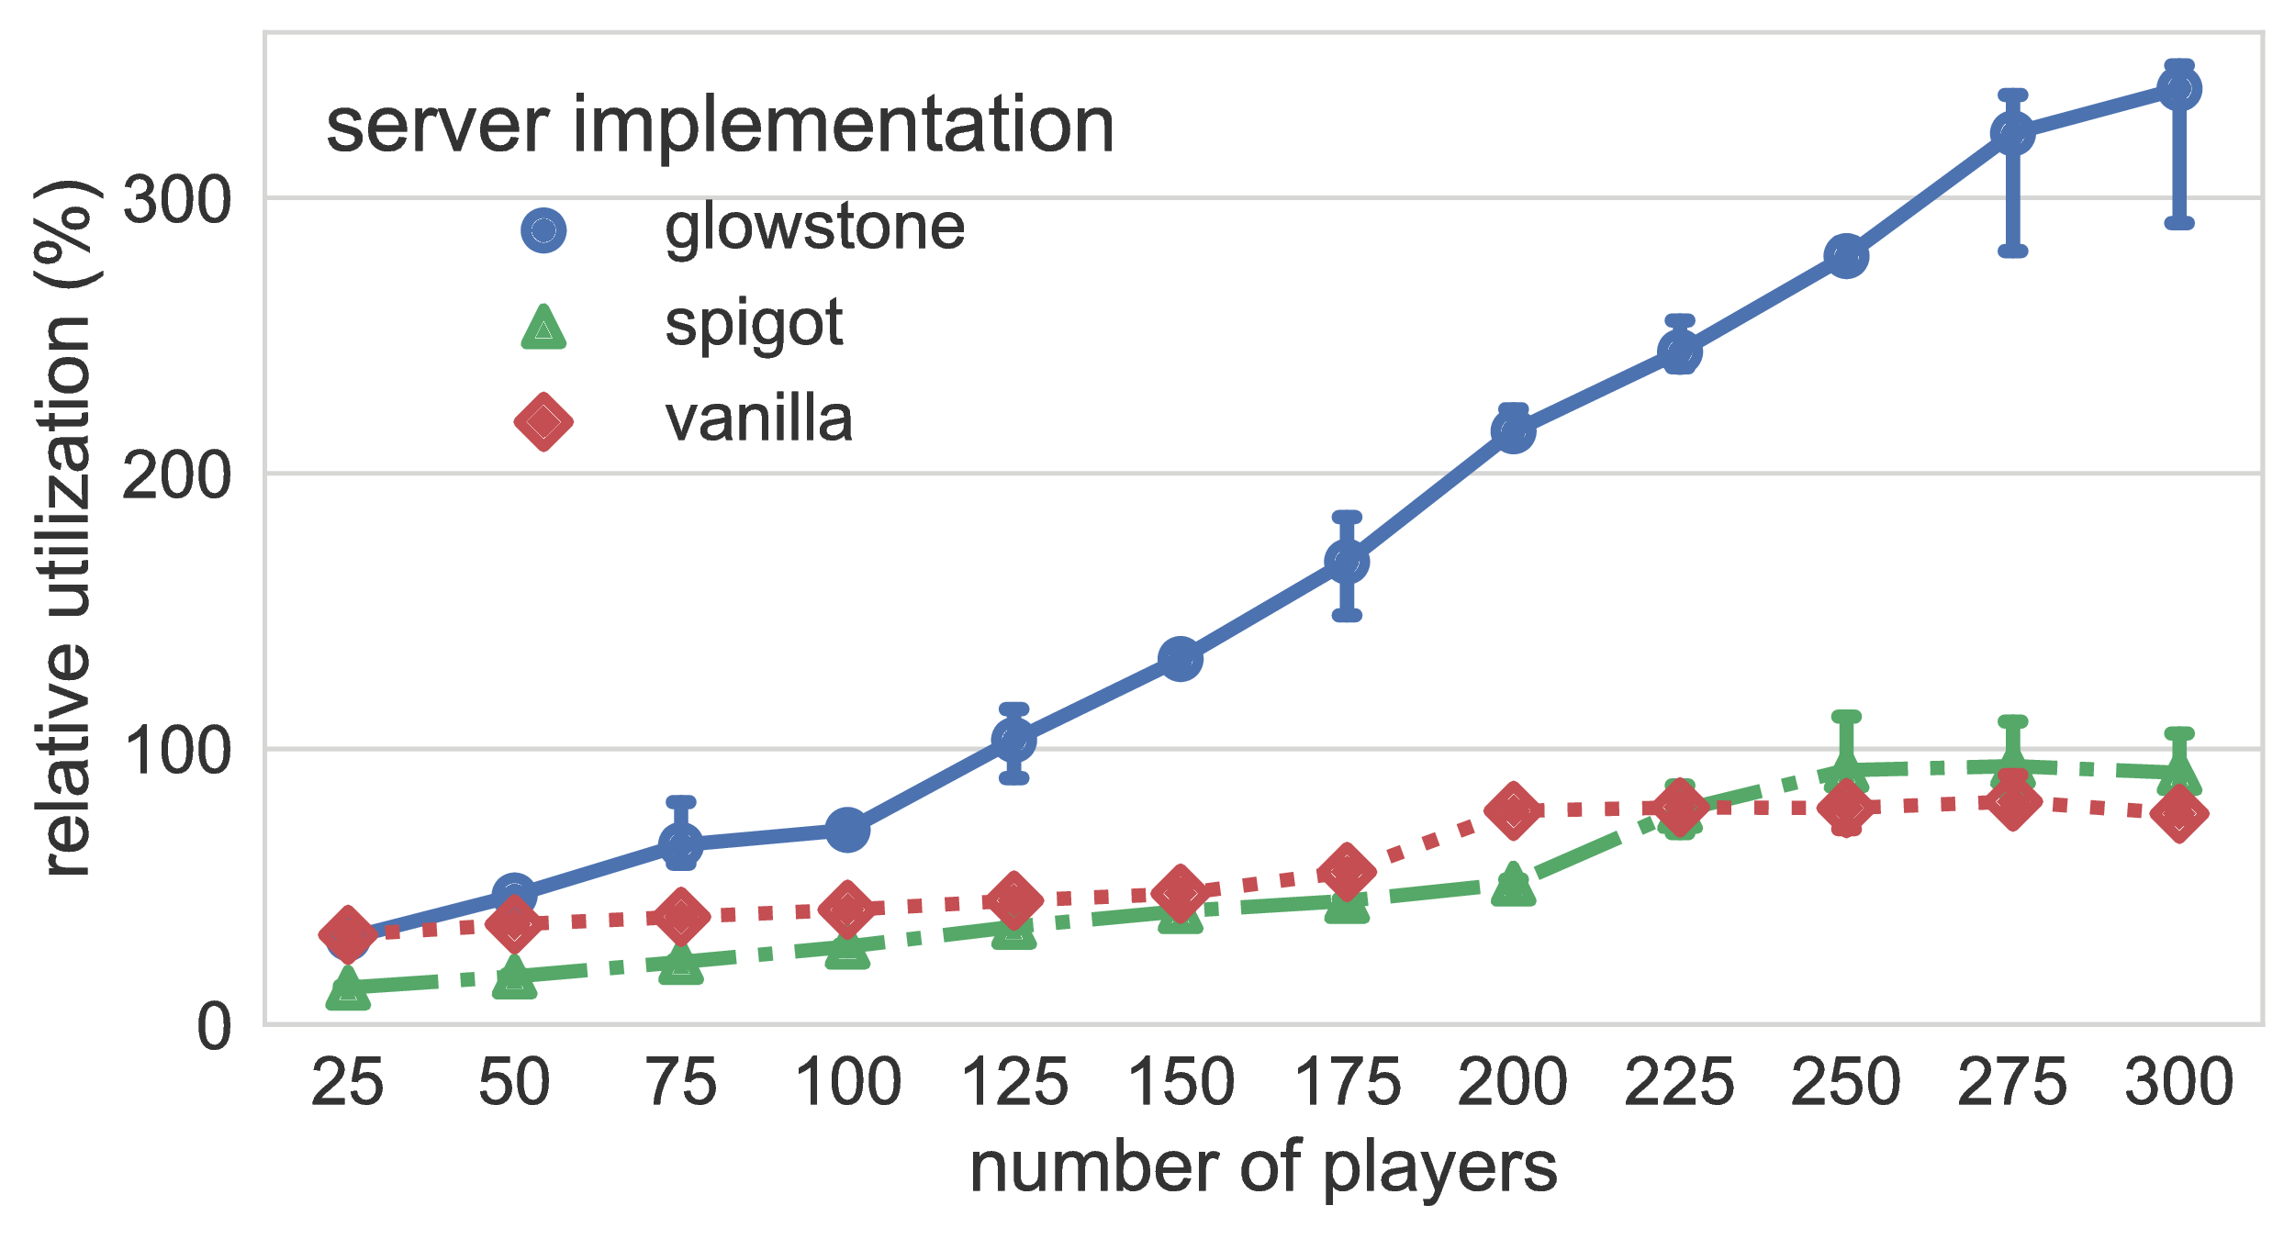
Yardstick: Tick Utilization
≈ 100% tick utilization
Notes:
Talk about
Player emulation
Vendorized Minecraft server
Results processing and virtual environment

Slide 22
Yardstick: Tick Utilization
≈ 100% tick utilization
Glowstone performs the worst
Notes:
Talk about
Player emulation
Vendorized Minecraft server
Results processing and virtual environment

Slide 23
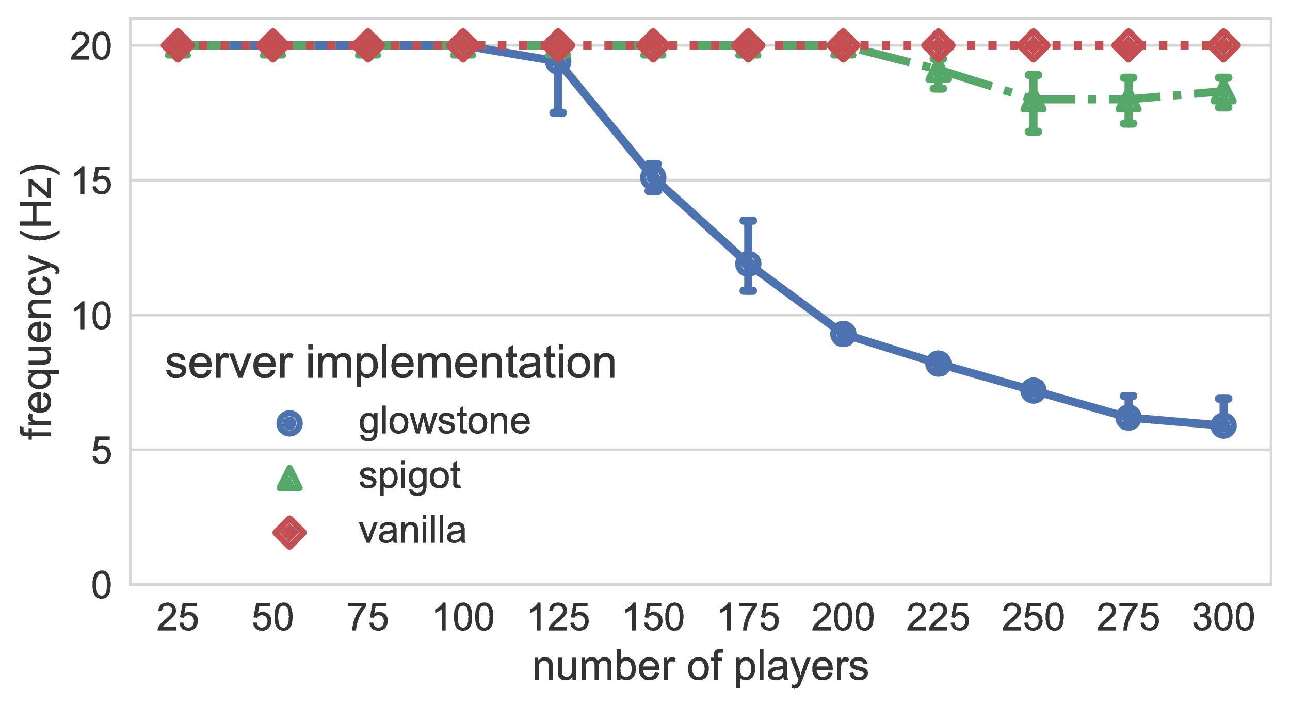
Yardstick: Update Frequency
≈ 125 players ⇒ freq. drops
Notes:
Talk about
Player emulation
Vendorized Minecraft server
Results processing and virtual environment

Slide 24
Yardstick: Update Frequency
≈ 125 players ⇒ freq. drops
Minecraft only scales to hundreds of players
Notes:
Talk about
Player emulation
Vendorized Minecraft server
Results processing and virtual environment

Slide 25
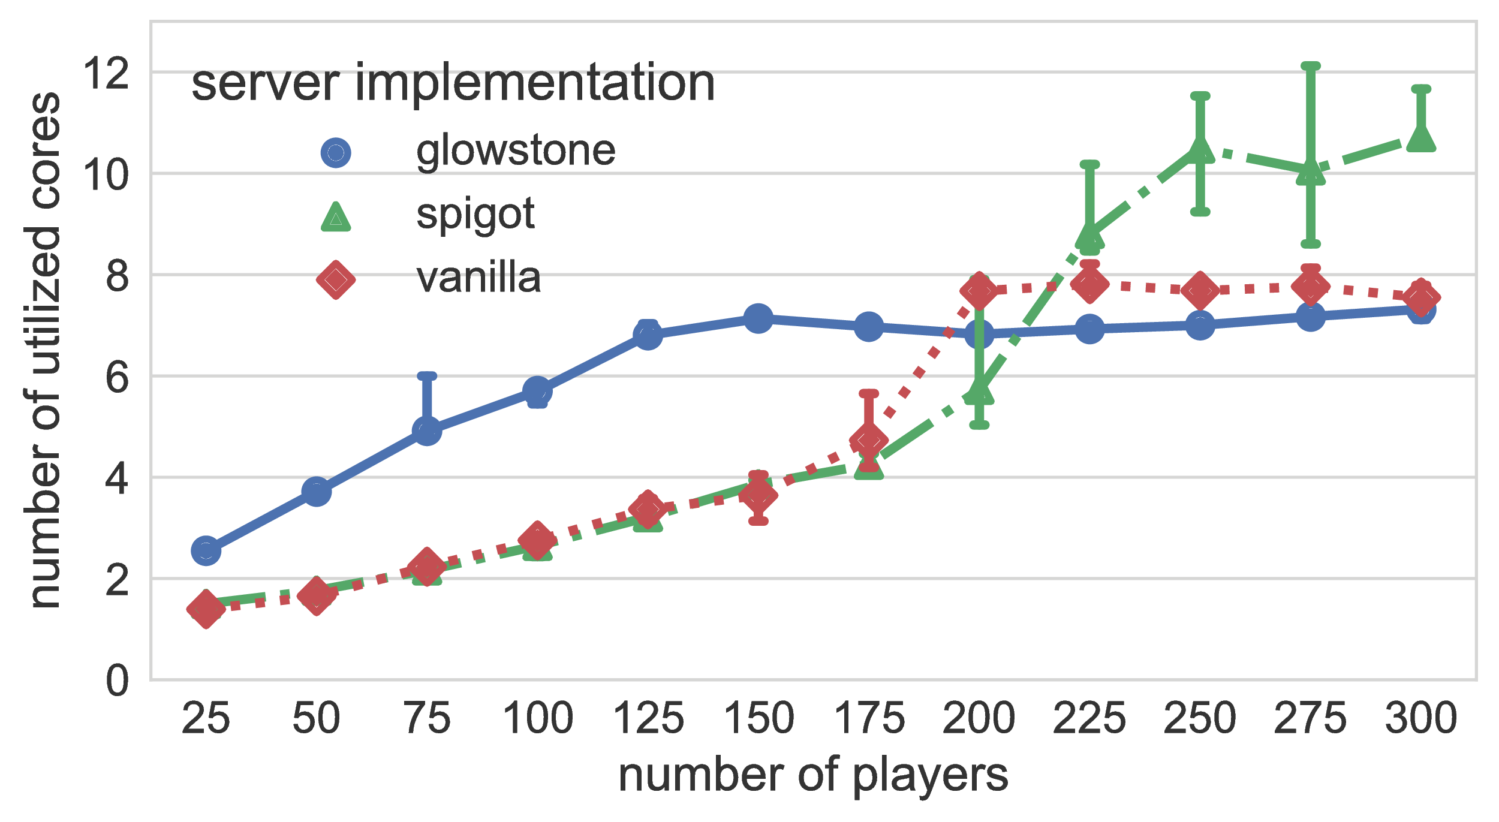
Yardstick Results: CPU Utilization
Never uses all 16 cores!

Slide 26
Yardstick Results: CPU Utilization
Q: Why does tick freq. drop when not all cores are used?
A: Minecraft-like services are poorly parallelized!
Never uses all 16 cores!

Slide 27
Wrapping Up

Slide 28
Yardstick: Future Work
Future work:
Realistic player emulation based on real-world message dumps
Support for all major server implementations
Complex interactions with the virtual environment
Notes:
Meerkat:
→ Dynamic bounds
→ Multi-hop conits
→ Realistic workloads

Slide 29
Take-Home Message
Minecraft is a unique and interesting online game
Performance of Minecraft-like services is unclear
Yardstick = Benchmark targeted at Minecraft-like games
Minecraft-like services...
scale to hundreds of players
are poorly parallelized
use a lot of network to transfer the terrain

Slide 30
Talk To Us at These Places:
Yardstick
@Large Research
Delft University of Technology & Vrije Universiteit Amsterdam
www.atlarge-research.com/opencraft
opencraft@atlarge-research.com
Jerom van der Sar
J.vanderSar@atlarge-research.com
Jesse Donkervliet
J.Donkervliet@atlarge-research.com
Alexandru Iosup
A.Iosup@vu.nl
(So long, and thanks for all the fish)

